Slide 1



CS4352 Operating Systems
Final review: Part 1

Slide 2
What Is An Operating System (1)
A modern computer consists of:
One or more processors
Main memory
Disks
Printers
Various input/output devices
Managing all these components requires a layer of software – the operating system
Not a shell/GUI (Graphical User Interface)

Slide 3
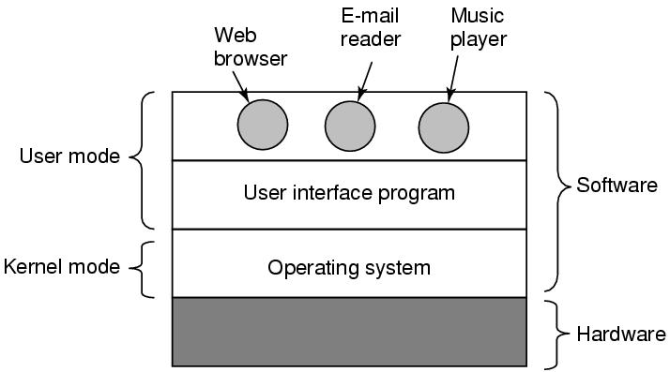
What Is An Operating System (2)
Figure 1-1. Where the operating system fits in.

Slide 4
Roles of An Operating System
Perform two basic functions:
Providing application programmers a clean abstract set of resources instead of the messy hardware ones (“extended machine”)
Managing hardware resources (“resource manager”)

Slide 5
Operating System as an Extended Machine (1)
Computer architecture at the machine language level is primitive and awkward to programmers
Instruction set
Memory organization
I/O
Bus structure
A simple, high-level abstraction desired
E.g. a collection of named files for read/write/close

Slide 6
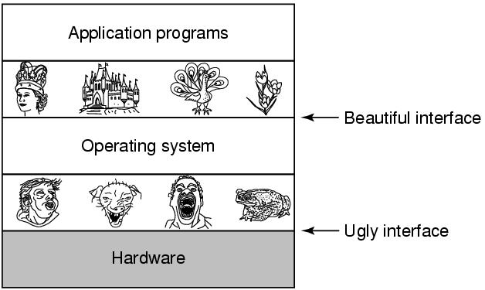
Operating System as an Extended Machine (2)
Hide the hardware ugly details and present programs (and their programmers)
with nice, clean, elegant, and consistent abstractions
Figure 1-2. Operating systems turn ugly hardware into beautiful abstractions.

Slide 7
Operating System as a Resource Manager (1)
A top-down view: OS as providing abstractions
A bottom-up view: OS manages all the pieces of resources
Processors, memories, timers, disks, networks, printers, etc.
Provide an orderly and controlled allocation for competing apps
E.g. a printer shared by multiple programs
E.g. memory and disks shared by multiple users

Slide 8
Operating System as a Resource Manager (2)
Managing and sharing (multiplexing) resources in two different ways
In time – time multiplexing
Multiple programs share a single CPU
In space – space multiplexing
Main memory and hard disks shared by multiple programs/users

Slide 9
What is multiprogramming?
Notes:
Multiprogramming is the rapid switching of the CPU between multiple processes in memory. It is commonly used to keep the CPU busy while one or more processes are doing I/O.

Slide 10
Special Registers
Program Counter (PC) ?
Contains the memory address of the next instruction to be fetched
“instruction address”
Stack Pointer (SP) ?
Points to the top of the current stack in memory
Memory divided into three segments “text” “data (heap)” “stack”
Program Status Word (PSW) ?
Contains the condition code bits, e.g. CPU priority, mode (user/kernel)
Needed in system calls and I/O
Managed by software (OS):
“context switch” for time multiplexing
Need to save/restore all these registers

Slide 11
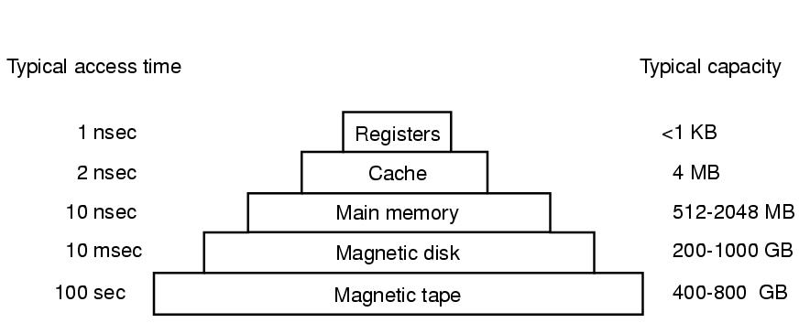
Memory Hierarchy
Closer to processor: faster, smaller, and more expensive
Figure 1-9. A typical memory hierarchy. The numbers are very rough approximations.

Slide 12
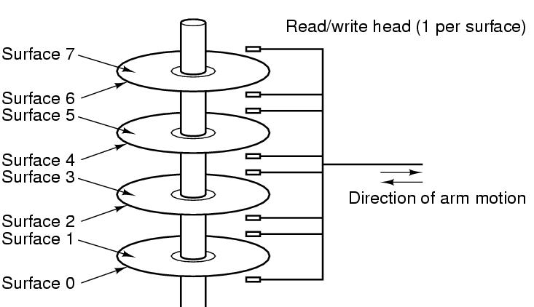
Disks (Hard Disk Drives)
90% of data stored in HDDs
Platter, surface, arm, head
Track, sector (fixed size, e.g. 512B)
Cylinder
Physical addressing (CHS)
Cylinder, Head, Sector
Flash-memory based storage will eventually replace
Figure 1-10. Structure of a disk drive.

Slide 13
I/O Devices
I/O devices heavily interact with OS (in addt. to CPU & memory)
Generally consist of
A controller: a chip/a set of chips controlling the device (can be complex)
The device itself, e.g. disks, NIC (network interface card)
Device Driver
The software that talks to the controller
Part of OS (can run kernel mode), manage devices and hide dirty hardware details

Slide 14
Processes/Threads
Processes: running programs
Associated with an Address Space
text/program, data, stack
“core image”: content of address space
Associated with registers
Including PCs, SPs
Associated with other resources
List of open files, signals, related processes
Threads: lightweight processes, without own address space
A process is fundamentally a container that holds all the information needed to run a program
Notes:
Example: vide editor, web browser, email receiver.
Switch
Keep the same state it was stopped
Information explicated stored somewhere
Store in process table,
Core image for text, data, stack; process table for registers, other resources.

Slide 15
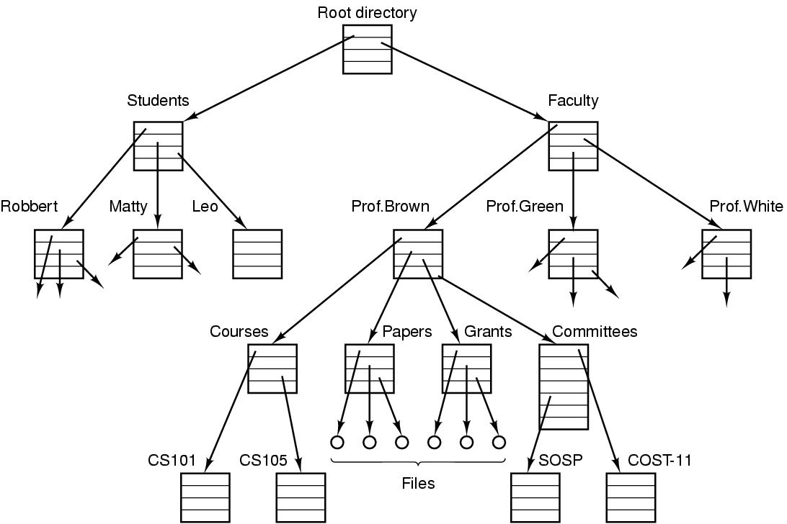
Files
File: an abstraction of a collection of bytes
Directory: a special file containing “pointer” to other files/directories
Root directory: top of the directory hierarchy
Path (absolute/relative)
/Students/Leo/foo
Working directory
File descriptor (FD)
File system: a collection of files, directories, and metadata
Figure 1-14. A file system for a university department.
Notes:
Comparing to process hierarchy , file trees can be deep but process trees are shallow, 3 level is rare
Process table lasts short time, minutes, but file tree lasts for years
Absolute path name vs relative
Working directory, system call to change, relative directory
Open a file, permission, file descriptor

Slide 16
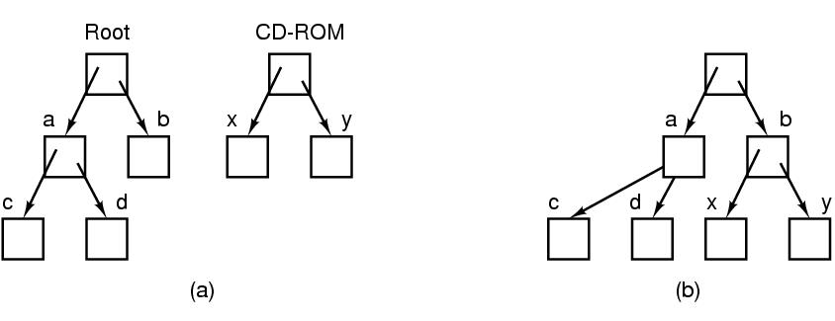
Files (cont.)
File systems can be joined with “mounting”
Figure 1-15. (a) Before mounting, the files on the CD-ROM are not accessible. (b) After mounting, they are part of the file hierarchy.

Slide 17
Protection and Security
User management (UID: User ID)
A superuser “root” with UID=0 in Unix
Group management (GID: Group ID)
Protection mechanisms exist in OS for security
E.g. files in Unix are protected with a 9-bit binary code
Three 3-bit fields, for owner, group members, and everyone else
A 3-bit field: rwx bits, indicate the privilege of read/write/execute
E.g. rwxr-x—x. How to change permission?
What are rwx for a directory?
Notes:
The first character is file type: - is for regular file, d is for directory, and so on.
For directory, x is for searching the content

Slide 18
Memory Layout
Figure 1-20. Processes have three segments: text, data, and stack.
Notes:
A text segment is also known as a code segment, a text segment is placed below the heap or stack in order to prevent heaps and stack overflows from overwriting it.
The text segment is read-only and sharable so that only a single copy needs to be in memory for frequently executed programs, such as text editors
Data segment is not read-only.

Slide 19
Figure 1-20. Processes have three segments: text, data, and stack.
Notes:
The stack grows the opposite direction of heap
When the stack pointer met the heap pointer, free memory was exhausted. What happen?
Each time a function is called, the address of where to return to and certain information about the caller’s environment, such as some of the machine registers, are saved on the stack. The newly called function then allocates room on the stack for its automatic and temporary variables.
Heap is the segment where dynamic memory allocation usually takes place.
The heap area begins at the end of the BSS segment and grows to larger addresses from there. The Heap area is managed by malloc, realloc, and free

Slide 20
Processes
Process: a running program, associated with all resources
Address space
Registers
Open files
Etc.
A program running twice (two “instances”) creates two processes (can possibly share the text segment)
Abstraction supports multiprogramming
Support pseudo concurrent operation even on single (uni-core) CPU
“pseudoparallelism”

Slide 21
Process States
What are different states of a process?
Please explain the transitions between process states.

Slide 22
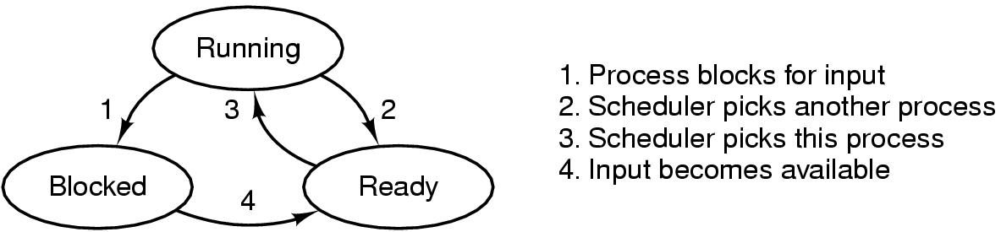
Process States
Process scheduler
Figure 2-2. A process can be in running, blocked, or ready state. Transitions between these states are as shown.
Notes:
From Running, what is the difference between 1 and 2
Can we go from Blocked to Running?
Can we go from ready to blocked?

Slide 23
Threads
Threads: lightweight processes
Multiple threads of control but share an address space
Why threads are desired?
Ability of share an address space and data
Lightweight and easier to create and destroy (creating a thread is 10 to 100 times faster than creating a process)
Performance gain for mixed computing and I/O (higher degree of parallelism)
Map to multithreaded/multicore processors

Slide 24
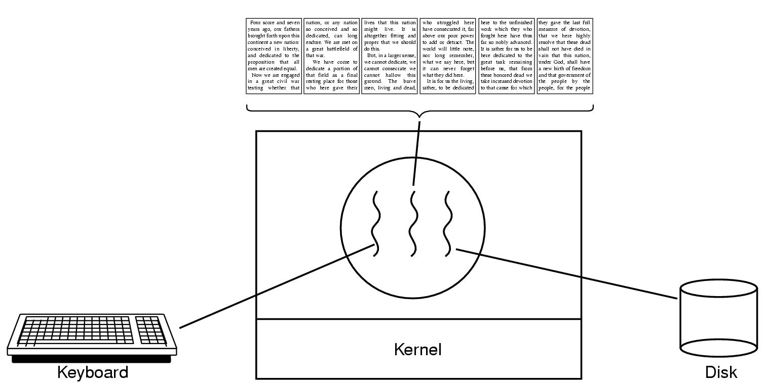
Thread Usage (1)
Figure 2-7. A word processor with three threads.

Slide 25
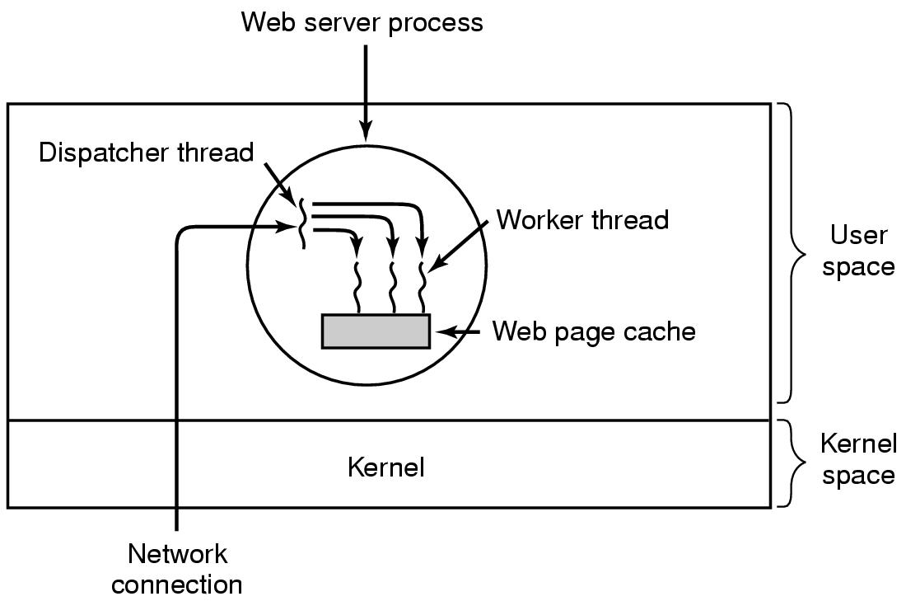
Thread Usage (2)
Figure 2-8. A multithreaded Web server.
Notes:
Why do we need cache?
Multiple threads can share global variables. For ex, number of accepted html requests.

Slide 26
Implementing Threads in User Space (1)
In user space
Entirely in user space, kernel knows nothing
Kernel manages ordinary single-threaded processes
User-level threads can be implemented on an operating system that does not support threads (in kernel)

Slide 27
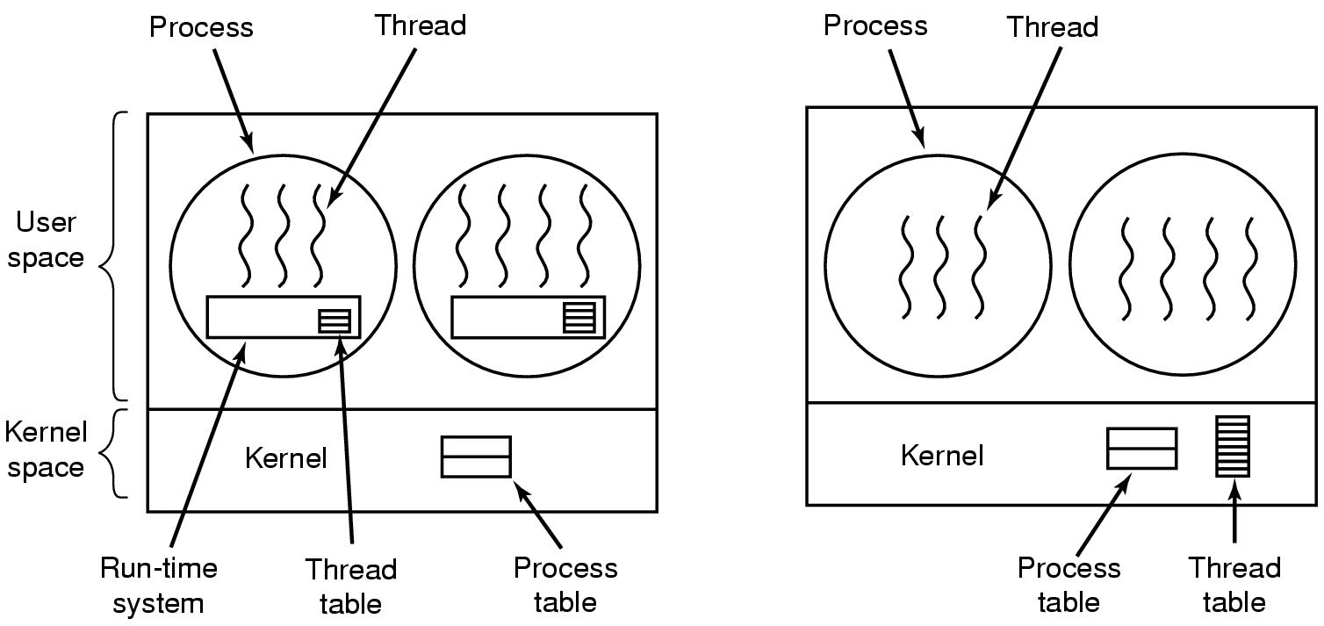
Implementing Threads in User Space (2)
Figure 2-16. (a) A user-level threads package

Slide 28
Implementing Threads in User Space (3)
Advantages
Fast thread switching than trapping to the kernel (an order of magnitude faster normally)
Each process can have its own customized scheduling algorithm
Disadvantages
Blocking system calls
Page faults (detailed discussion when studying chapter 3)
Limited performance gain (system calls block threads)
Notes:
Fast thread switching because no trap, not context switching, no cached memory flushed.

Slide 29
Implementing Threads in Kernel Space (1)
In kernel space
No run-time system and thread table needed in each process
Kernel manages a thread table keeping track of threads
Thread table holds the same info as with user-level threads

Slide 30
Implementing Threads in Kernel Space (2)
Figure 2-16. (b) A threads package managed by the kernel.

Slide 31
Implementing Threads in Kernel Space (3)
Advantages
When a thread blocks, the kernel can schedule another thread from the same process (if ready) or a thread from a different process to run
No new nonblocking system calls required (including dealing with page faults)
Performance gain
Disadvantages
Higher cost of creating/destroying threads (system calls)
Notes:
Other issues remain, e.g. multithreaded process forks/signals

Slide 32
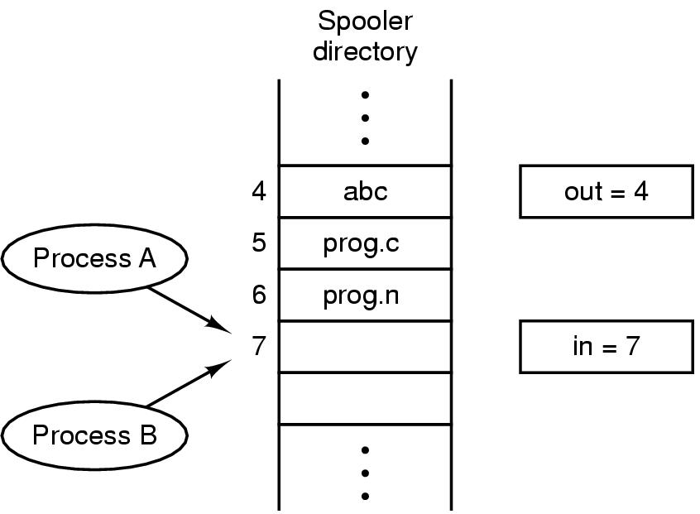
Race Conditions
In IPC, where two or more processes read/write some shared data, if the final result depends on who runs precisely when, such a situation is called race conditions
Figure 2-21. Two processes want to access shared memory at the same time.

Slide 33
Critical Regions (1)
Mutual exclusion needed to avoid race conditions
Applies to shared memory, shared files, and shared everything else
Part of the program where shared resources are accessed is called the critical region or critical section
No two processes may be simultaneously inside their critical regions.
No assumptions may be made about speeds or the number of CPUs.
No process running outside its critical region may block other processes.
No process should have to wait forever to enter its critical region.
Notes:
Mutual exclusion make sure that if 1 process use a shared file/variable, other processes will be excluded from doing the same thing.

Slide 34
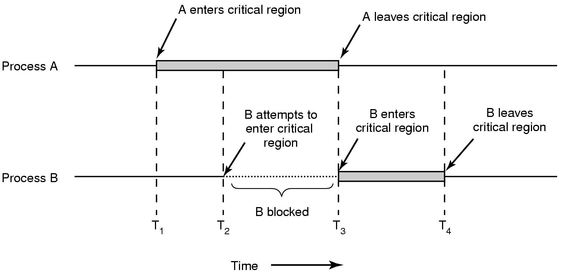
Critical Regions (2)
Figure 2-22. Mutual exclusion using critical regions.

Slide 35
Mutual Exclusion with Busy Waiting
Proposals for achieving mutual exclusion:
Disabling interrupts (doesn’t work for multicore chips. Why?)
Lock variables (set the lock variable to 1 when after entering. What problem?)
Strict alternation
Peterson's solution
The TSL/XCHG instruction
Notes:
Disabling interrupts: unattractive to give control to user processes? Since it can disable interrupts and run forever.
Disabling interrupts can be used in OS, for example to save data to a process table.
Disable interrupt Is from the process view.
Non-preemtive if from scheduler view

Slide 36
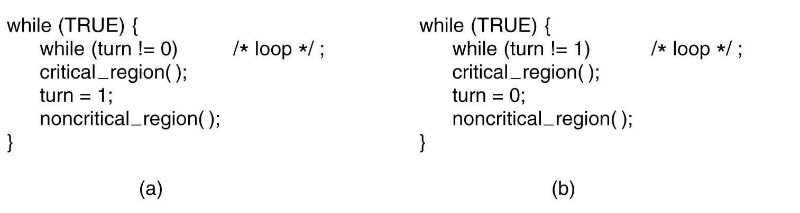
Strict Alternation
Busy waiting
Spin lock
Figure 2-23. A proposed solution to the critical region problem. (a) Process 0. (b) Process 1. In both cases, be sure to note the semicolons terminating the while statements.
Notes:
This is called bus waiting. This should be avoid since wasting CPU.
This also violate condition 3. Why?

Slide 37
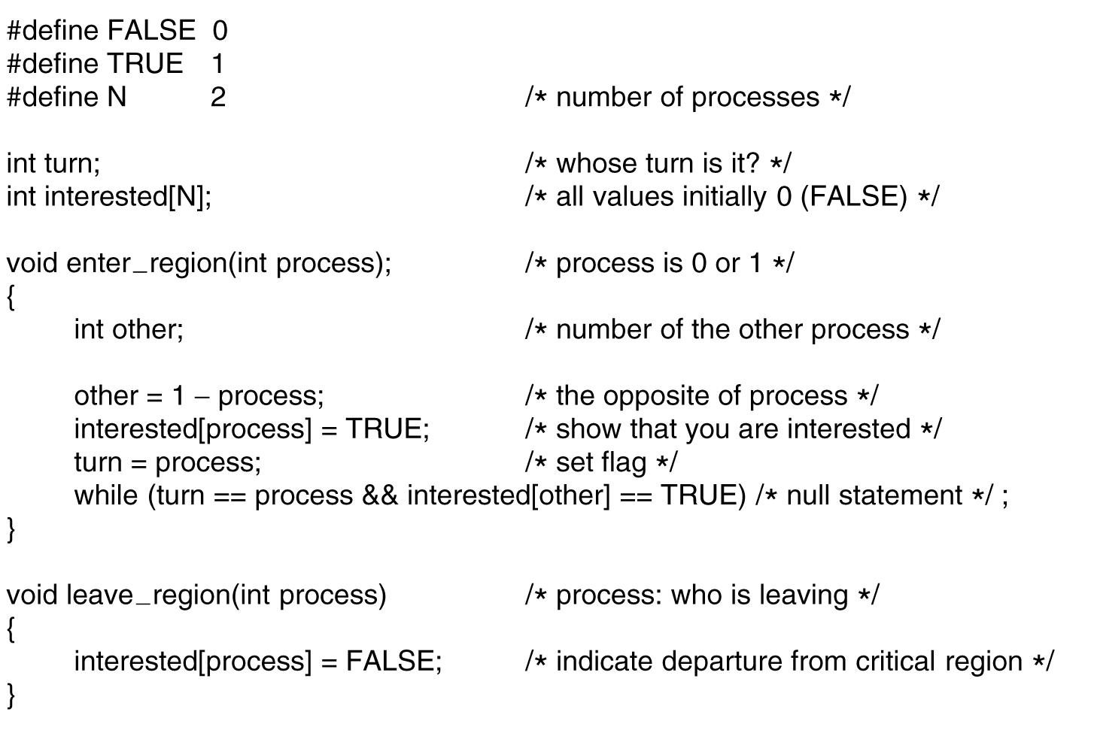
Peterson's Solution
Figure 2-24. Peterson’s solution for achieving mutual exclusion.
Notes:
If one process enter region -> fine
If both enter the region? -> fine why?

Slide 38
Sleep and Wakeup
Previous solutions have the defect of requiring busy waiting
If an entry not allowed, sits in a tight loop waiting until it is
Wastes CPU cycles
IPC primitives block (and release CPU) instead of wasting CPU cycles
Sleep: a system call causes the caller to block and release CPU until another process wakes it up
Wakeup: a system call wakes up another process
Notes:
Sleep and wakeup are not part of standard C, but presumably we have these system calls

Slide 39
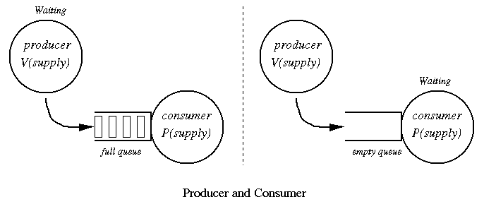
The Producer-Consumer Problem

Slide 40
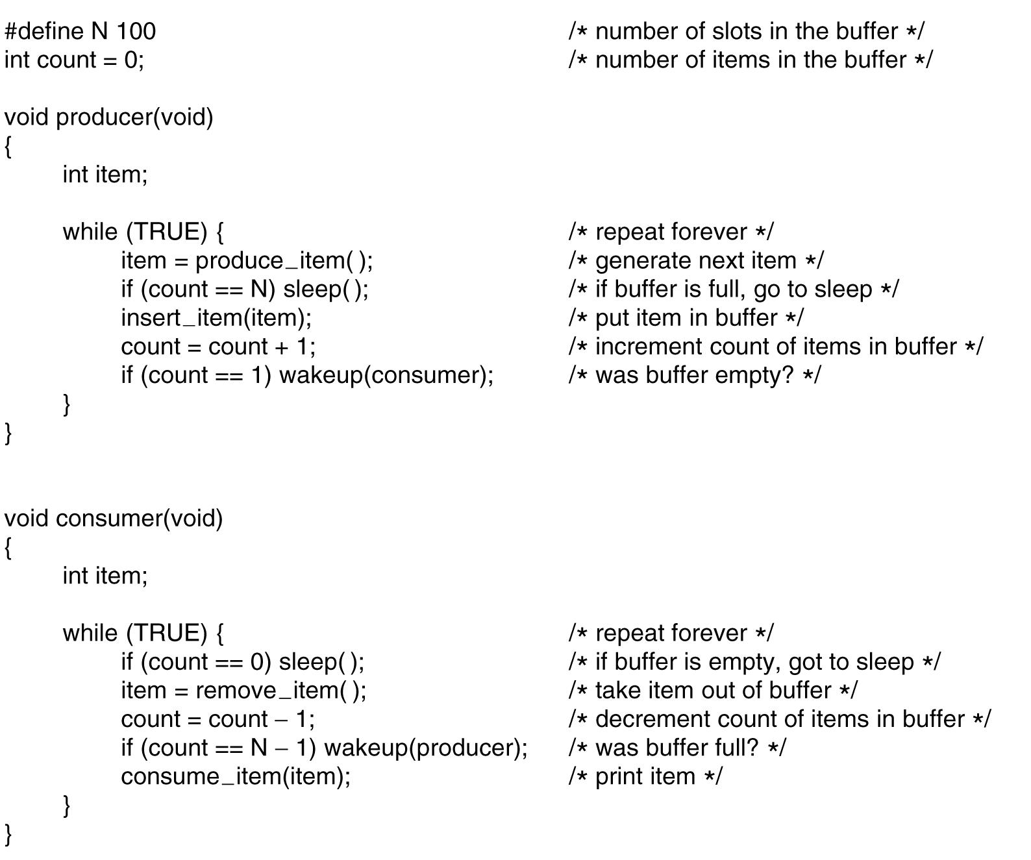
The Producer-Consumer Problem
Figure 2-27. The producer-consumer problem with a fatal race condition.
Notes:
What problem? When count==0 then consumer decide to sleep, but before he sleeps the producer try to wake him up -> he still sleep since he did not know.
Sooner or later, the producer will fill up the buffer and got to sleep as well -> both will sleep forever.
Solution? Waken bit. This works like a note from producer to consumer.

Slide 41
Semaphores (1)
Introduced by E. W. Dijkstra in 1965
A variable type semaphore (integer) to count # of wakeups
“down” operation: decrements if greater than 0 (uses one stored wakeup) or sleep if the value is 0
“up” operation: increments the value and one of sleeping processes waken up to complete its down
Both operations completed as a single indivisible atomic action
Also referred as P and V operations
P: Proberen (try), V: Verhogen (raise, make higher)

Slide 42
Semaphores (2)
“up” and “down” are usually implemented as system calls
With the OS briefly disabling all interrupts while testing the semaphore, updating, putting the process to sleep if needed
Notes:
Check the value of semaphore, change it, and possibaly go to sleep is on single atomic action

Slide 43
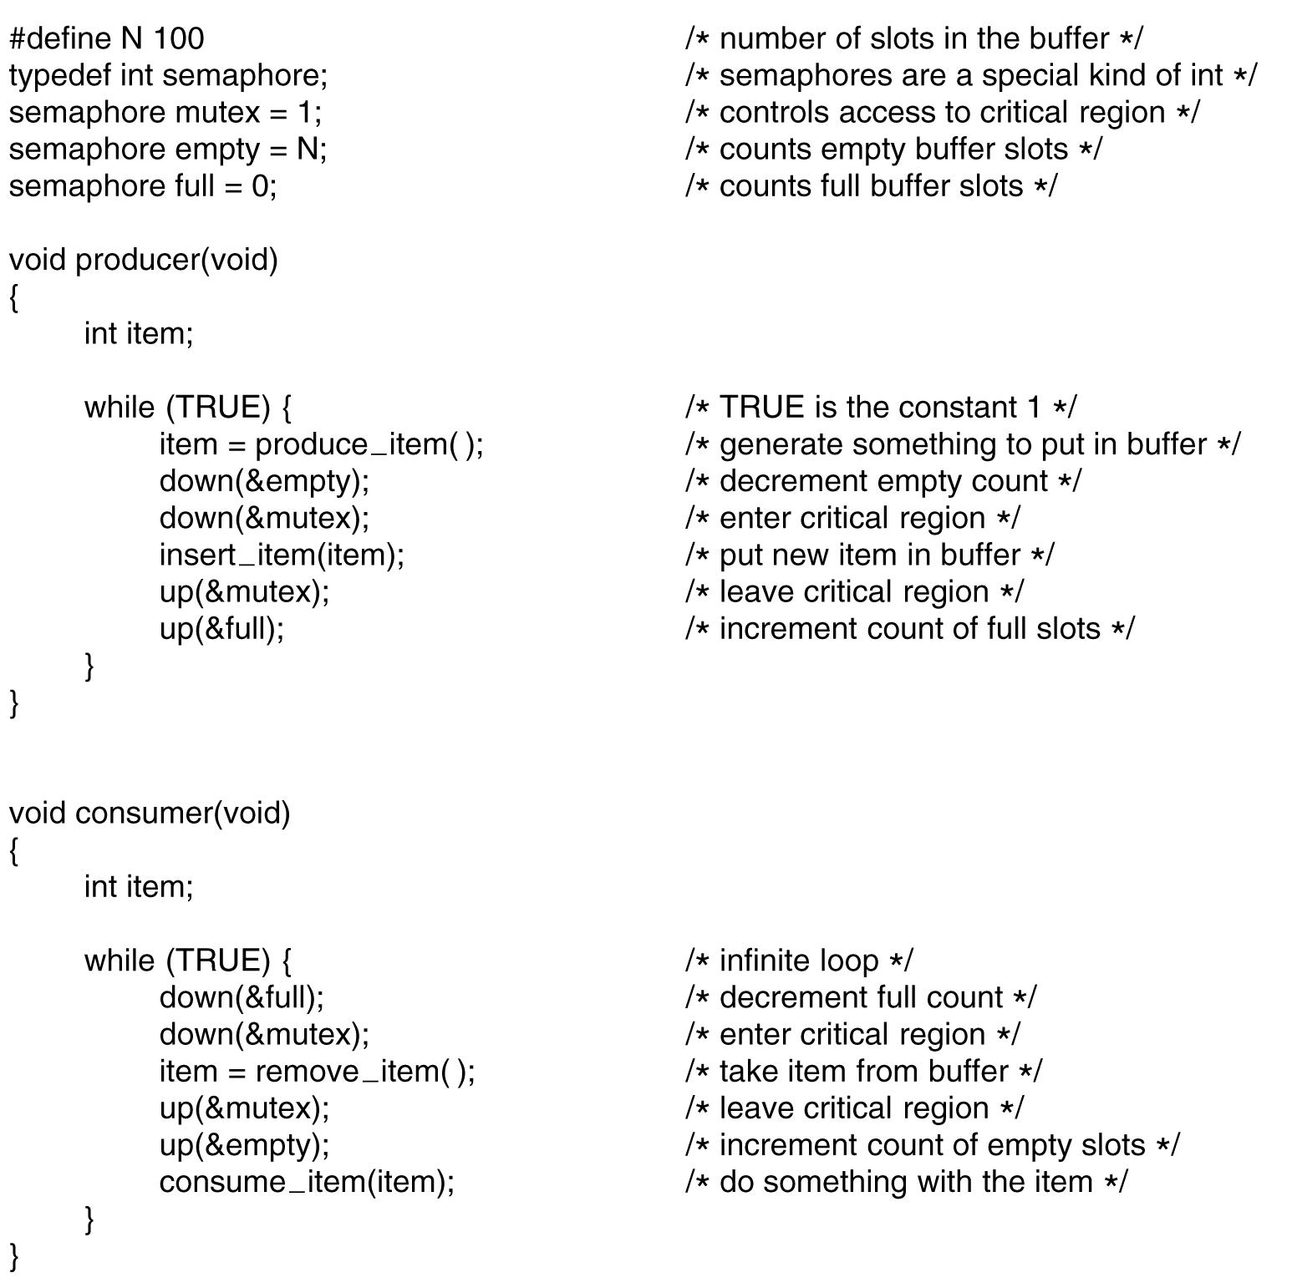
Three semaphores, full, empty, and mutex
full and empty are used for synchronization
mutex used for mutual exclusion
Can cause “deadlock” if the order switched
Figure 2-28. The producer-consumer problem using semaphores.

Slide 44
Mutexes
A simplified version of semaphore when count is not needed
A mutex variable has only two states: unlocked and locked
Sometimes called “mutex lock”, “binary semaphore”
Good and efficient for managing mutual exclusion
1 bit needed for implementation
An integer can also be used: 0 unlocked, and other value locked
mutex_lock/mutex_unlock procedures
If the mutex is unlocked, the mutex_lock call succeeds; otherwise blocked until mutex_unlock called

Slide 45
Outline
Questions?
InterProcess Communication
Mutexes, Monitors
Message passing, Barriers
Scheduling
Process behavior and when to schedule
Categories of scheduling algorithms and goals
Scheduling in batch systems and interactive systems
Policy v.s. mechanism, thread scheduling

Slide 46
Scheduling
Whenever two or more processes/threads compete for the CPU to run, we need a form of “scheduling”
Scheduler: the OS component makes the scheduling decision
Scheduling algorithm: the algorithm the scheduler uses
Process/thread scheduling share similar issues, but with subtle difference too

Slide 47
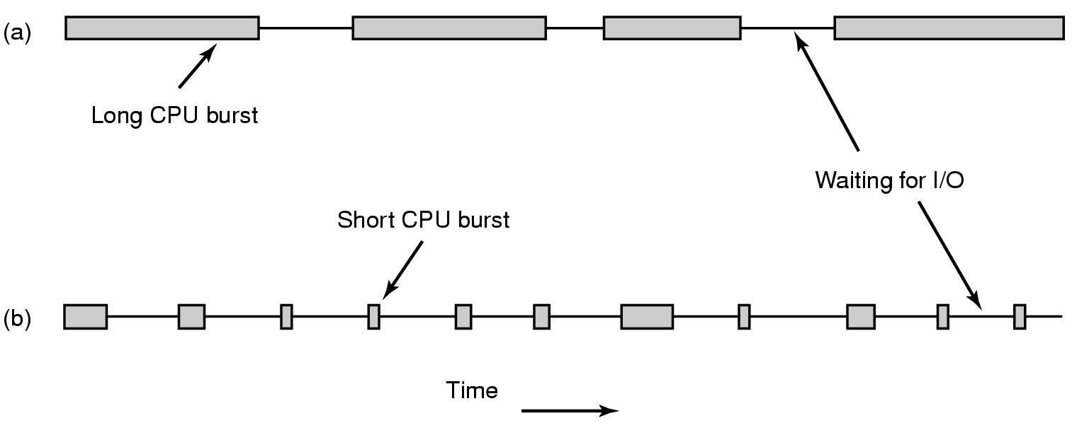
Process Behavior (1)
Figure 2-38. Bursts of CPU usage alternate with periods of waiting for I/O. (a) A CPU-bound process. (b) An I/O-bound process.

Slide 48
Process Behavior (2)
Compute-bound: spend most time computing
I/O-bound: spend most time waiting for I/O

Slide 49
When to Schedule
When a new process created
When a process exits
When a process blocks on I/O, on a semaphore, etc.
When an I/O interrupt occurs
Nonpreemptive
Preemptive
Notes:
Preemtive: 5ms
Nonpreemptive (run until completion): process will volenteer to give up CPU on its I/O

Slide 50
Scheduling in Batch Systems (1)
First-Come First-Served (FCFS)
Nonpreemptive
Processes are assigned CPU in the order they request it
Single queue of ready processes
When a blocked process becomes ready, put on the end of queue
Easy-to-implement, fair, but low throughput, high turnaround time

Slide 51
Scheduling in Batch Systems (2)
Shortest Job First (SJF)
Nonpreemptive
Assumes run times are known
Scheduler picks the shortest job first
(a) has average turnaround times of 14 mins
(b) has average turnaround times of 11 mins
Figure 2-40. An example of shortest job first scheduling. (a) Running four jobs in the original order. (b) Running them in shortest job first order.

Slide 52
Scheduling in Batch Systems (2)
Shortest Job First (SJF)
Counter example on page 158

Slide 53
Scheduling in Batch Systems (3)
Shortest Remaining Time Next (SRTN)
Preemptive
Assumes run times are known
Scheduler picks the process whose remaining run time shortest
Newly arrived jobs are compared to current processes remaining time

Slide 54
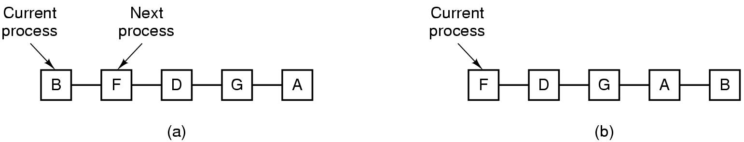
Scheduling in Interactive Systems (1)
Round-Robin (RR) Scheduling
Each process assigned a time interval, quantum
Preempted & switched (process switch/context switch) to other processes when quantum elapsed
Granularity of quantum: tradeoff, overhead & response time
Figure 2-41. Round-robin scheduling. (a) The list of runnable processes. (b) The list of runnable processes after B uses up its quantum.
Notes:
For example, processes need 1ms for context switching and 4ms for processing. Overhead =20%
Another example of 1ms and 99ms. Overhead = ? . Is this good for bus waiting?
Conclusion on page 159

Slide 55
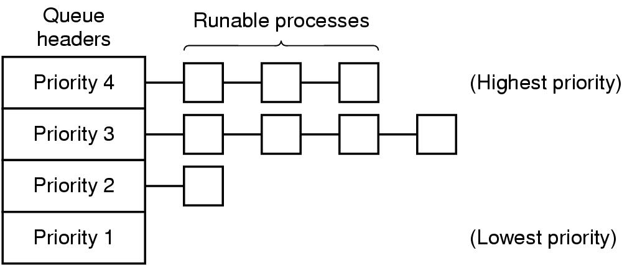
Scheduling in Interactive Systems (2)
Priority Scheduling
Each process assigned with a priority
Runnable process with highest priority allowed to run
Often combined with RR: priority among classes and RR in each class
Multiple Queues (MQ)
Figure 2-42. A scheduling algorithm with four priority classes.
Notes:
For example daemon process sending emails should be lower priority than music player.
To prevent higher priority process to run forever, we can decrease their priority, change priority dynamically.

Slide 56
Scheduling in Interactive Systems (3)
Lottery Scheduling
Processes given “tickets”
Scheduler picks a “ticket” randomly
Important processes can be given extra tickets
Fair-share Scheduling
Considers owners of processes
Each owner allocated portions of CPUs

Slide 57
CS4352 Operating Systems
Lecture Final: second part

Slide 58
Outline
Memory Abstraction: Address Space
Managing Free Memory
Virtual Memory
Paging
Page tables
Speeding up paging
Page tables for large memories

Slide 59
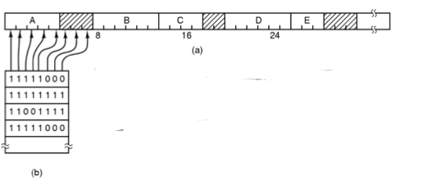
Memory Management with Bitmaps
Memory divided into allocation units and mapped to a bitmap
Size of allocation unit needs a balance (bitmap storage v.s. waste of allocation unit)
Drawback: need search (slow) to find out available memory
Figure 3-6. (a) A part of memory with five processes and three holes. The tick marks show the memory allocation units. The shaded regions (0 in the bitmap) are free. (b) The corresponding bitmap.
Notes:
Drawback: need search (slow) to find out available memory: bring a k-unit process into memory -> search for k consecutive bit of 0

Slide 60
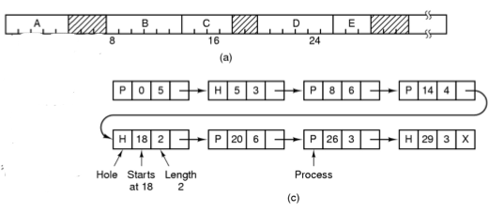
Memory Management with Linked Lists (1)
Linked list of segments
P: Process
H: Hole
Figure 3-6. (c) The same information as a list.

Slide 62
Memory Management with Linked Lists (3)
Memory allocation for process creation/swapped in
First fit (searches from the beginning of the linked list)
Next fit (searches from left off last time)
Best fit (take the smallest adequate hole, widely used, example fitting a process of size 2 into Fig 3-6)
Worst fit (takes the largest hole, example fitting two processes of size 1 and then 2 into Fig 3-6)
Quick fit (quick allocation for common sizes, e.g. maintaining extra lists of points to 4KB, 8KB … time and space trade-off )
Notes:
We assume that memory management know how much memory to allocate for the process

Slide 63
Outline
Questions?
Memory Abstraction: Address Space
Managing Free Memory
Virtual Memory
Paging
Page tables
Speeding up paging
Page tables for large memories

Slide 64
Virtual Memory
Driven by the need of running programs that are too large to fit in memory (or collectively with multiple programs)
Each process has its own address space, divided into pages
Pages mapped onto physical memory (not all)
When a process refers part of address space in physical memory, a hardware/software performs mapping on the fly
When not in memory, the OS load and re-execute instruction
Notes:
Designed by John Fotheringham in 1961

Slide 65
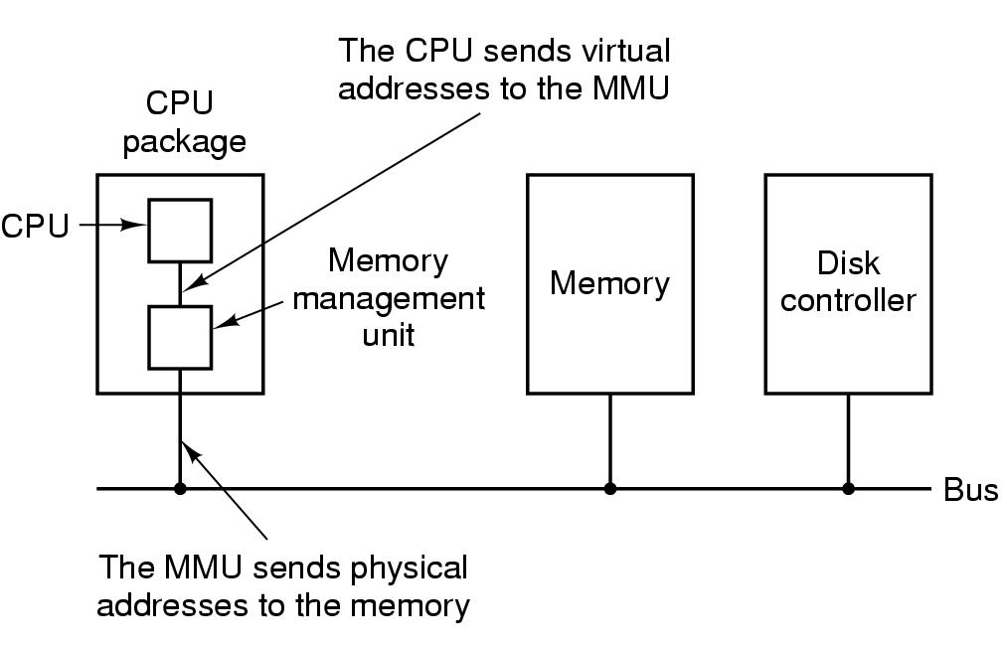
Paging (1)
Paging
Virtual address (CPU generated)
Virtual address space
MMU (Memory Management Unit)
Figure 3-8. The position and function of the MMU – shown as being a part of the CPU chip (it commonly is nowadays). Logically it could be a separate chip, was in years gone by.

Slide 66
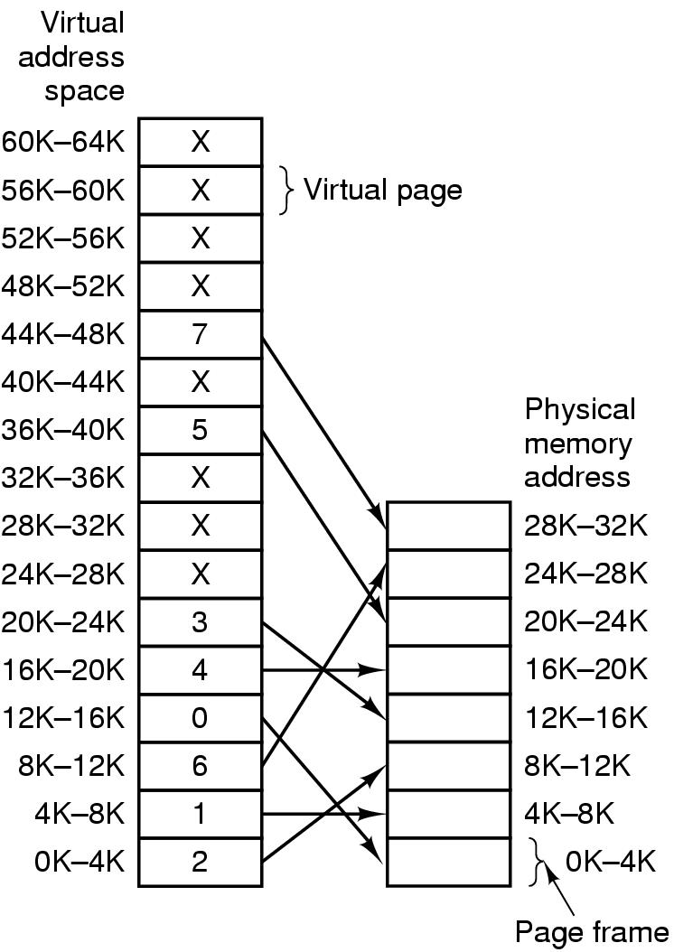
Paging (2)
Pages
Page frames
Page table (mapping function)
Page fault
Present/absent bit
Figure 3-9. Relation between virtual addresses and physical memory addresses given by page table.
Notes:
Where is the physical memory located? Where is the virtual memory located?
What is the size of the physical memory in the picture? = 32K

Slide 67
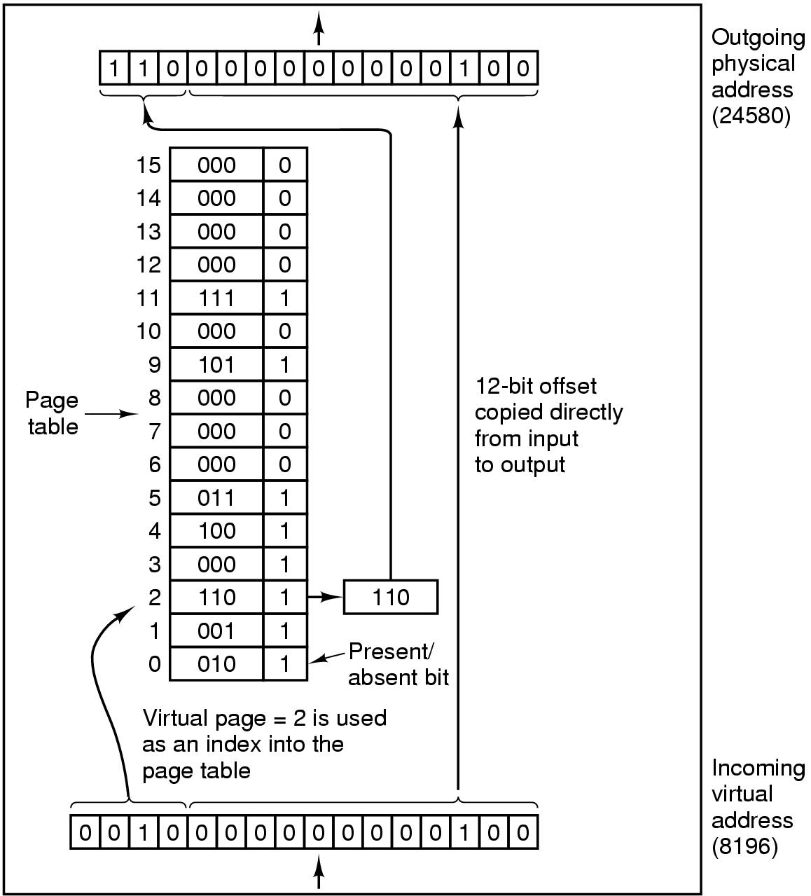
Paging (3)
64KB of virtual address space (16 4KB pages) mapped onto 32KB of physical memory
Page number used as an index into the page table (mapping function)
Figure 3-10. The internal operation of the MMU with 16 4-KB pages.

Slide 69
Paging implementation issues:
Virtual address to physical address mapping must be fast
Must be done every memory reference
If virtual address space is large, the page table will be large
With 4KB page size, 32-bit address -> how many pages,
With 4KB page size, 64-bit address -> how many pages,
Notes:
With 4KB page size, 32-bit address has 1M (2²⁰) pages,
64-bit address has 2⁵² (4K trillion) pages

Slide 70
Outline
Questions?
Virtual Memory
Paging, Page tables
Speeding up paging
Page tables for large memories
Page Replacement Algorithms
Optimal algorithm
NRU, FIFO, Second-chance algorithms
Clock, LRU, Aging algorithms
Working set
Summary

Slide 71
Page Replacement Algorithms
When a page fault occurs, if page frames full, OS needs to choose a page to evict to make room
Similar to cache line replacement
Different in how fast they require
If the evicted page is dirty, it needs to be written back to disk
If clean, no rewrite needed
Naïve random algorithm possible, but we can do a better job!
Notes:
Page Replacement occurs in other areas of computer design: web browsers, catch in CPU.

Slide 72
Optimal Page Replacement Algorithm (OPT)
Best possible algorithm is to pick the page who has the furthest distance to be accessed again
E.g. if pages A, B, C, D in memory, E is referenced and needs to replace a page, with future accesses A, C, D, B, C, …Which one to be picked?
B
Impossible to implement though, need a magic fortune teller!

Slide 73
Not Recently Used (NRU)
Associate two bits for each page
R: reference bit, set when referenced (read/written)
M: modified bit, set when written
OS classifies into 4 classes and NRU picks a random page from the lowest-numbered nonempty class (higher priority to stay with reuse)
Class 0: not referenced, not modified
Class 1: not referenced, modified
Class 2: referenced, not modified
Class 3: referenced, modified
Notes:
Referenced is reset by OS every clock cycle (interrupt): Class 1 can achieved by resetting Referenced on class 3 on clock cycle.
Referenced is more important than Modified in NRU. For example: class 2 and class 1

Slide 74
First-In First-Out (FIFO)
FIFO picks the oldest page as the victim page to be replaced
Low-overhead, little book-keeping, easy to implement (FIFO queue)
Issue: ?
heavily-used early arrival page can be replaced

Slide 75
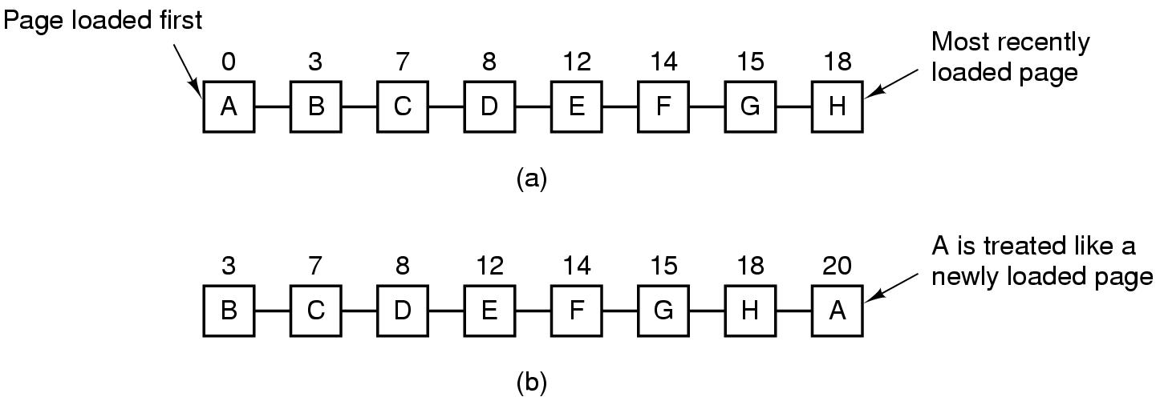
Second Chance Algorithm
Follows FIFO, but check R bit; if 0, replaced; if 1, clear R bit and put into the end of the queue
Figure 3-15. Operation of second chance. (a) Pages sorted in FIFO order. (b) Page list if a page fault occurs at time 20 and A has its R bit set. The numbers above the pages are their load times.
Notes:
What if are pages are referrenced in the Figure A? -- > It become FIFO

Slide 76
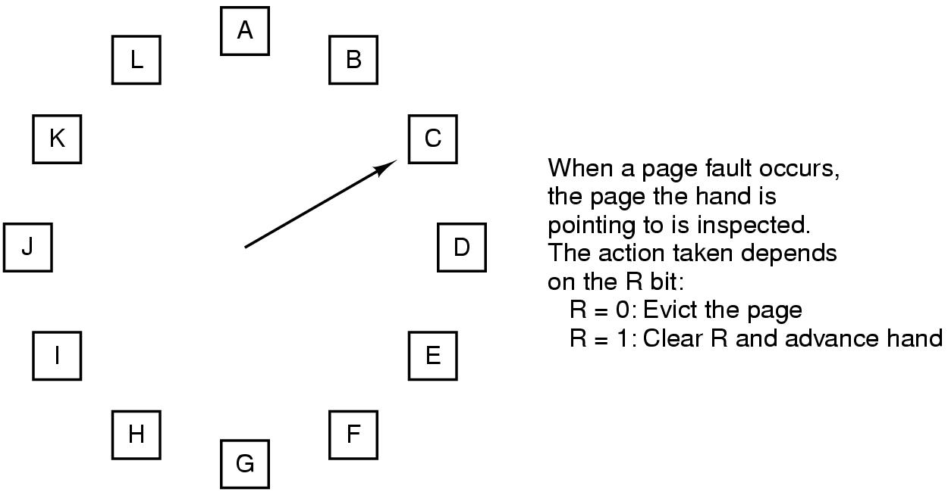
The Clock Page Replacement Algorithm
Figure 3-16. The clock page replacement algorithm.
Notes:
Similar to FIFO with second chance. But this move the pointer instead of move the page to the end of the list

Slide 77
Least Recently Used (LRU) Algorithm (1)
LRU picks the page that has not been used for the longest time
Good approximation of OPT
Not cheap to implement though
Needs a linked list and needs to update this linked list on every memory reference
Hardware implementations
With a counter incrementing after each instruction (“timer”); each page table entry stores a counter value, entry with lowest counter picked
With a matrix of n x n bits, for n page frames

Slide 78
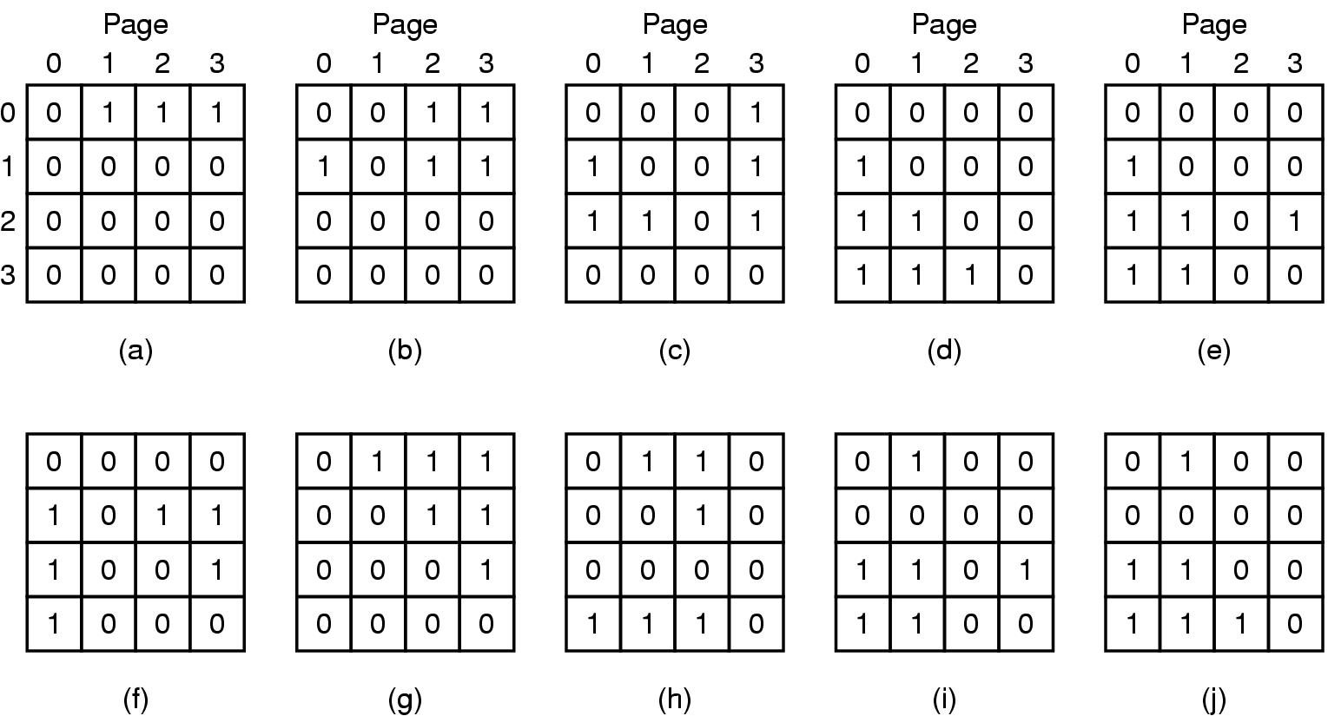
Least Recently Used (LRU) Algorithm (2)
When page frame k referenced, row k sets to 1, col k sets to 0
Row with lowest binary value picked
LRU using a matrix when pages are referenced in the order 0, 1, 2, 3, 2, 1, 0, 3, 2, 3.
Notes:
By setting row sets to 1, he makes sure he is the highest priority
Setting col to 0 reserves the order of priorities. Why? Notice that after after c) all rows have 1 different bit
LRU requires a field (usually 64 bit) in each page table entry

Slide 79
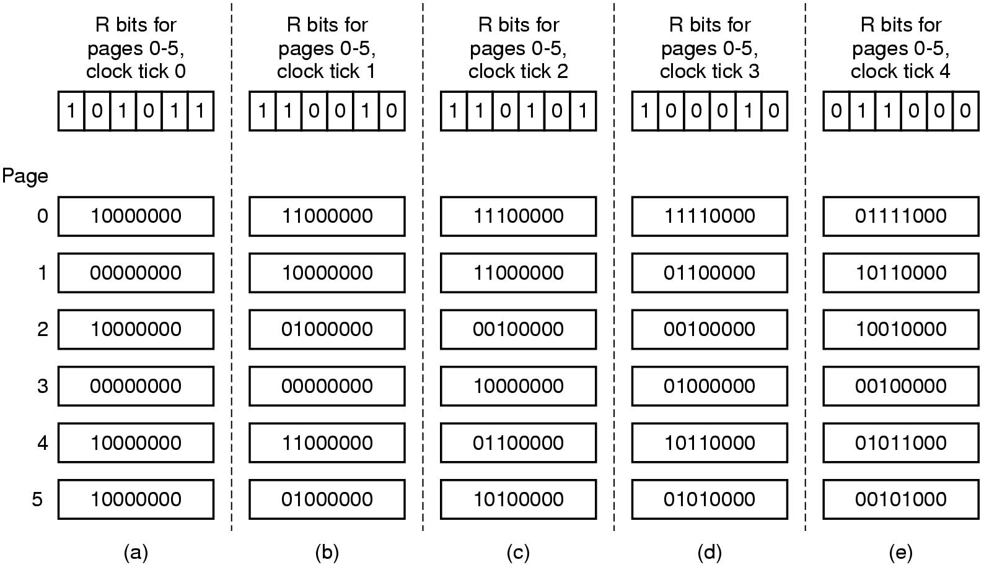
Simulating LRU in Software – Aging Algorithm
Software counter associated with each page
Counter shifted right 1 bit, and R bit added in to the leftmost, at each clock interrupt
Not exact LRU, e.g. pages 3 and 5 after not referenced a while
Figure 3-17. The aging algorithm simulates LRU in software. Shown are six pages for five clock ticks. The five clock ticks are represented by (a) to (e).
Notes:
We are able distinguish within 8 clock cycle but not more than 8 clock cycle

Slide 80
Working Set Page Replacement (1)
The set of pages a process currently using called working set
Principle of locality
Thrashing: if a process has frequent page faults e.g. every few instructions
Demand paging
Prepaging (working set model)
Working set page replacement algorithm
Find a page not in the working set and evict it

Slide 81
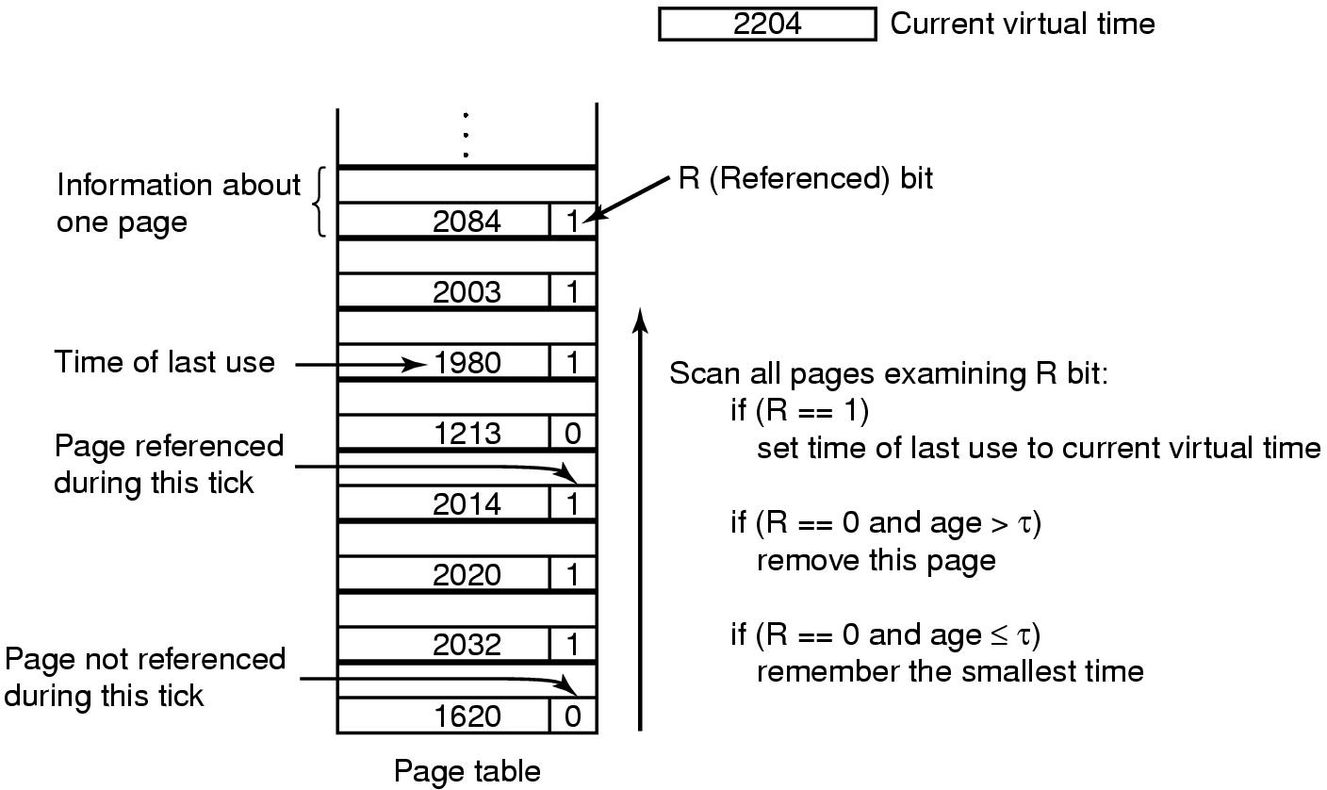
Working Set Page Replacement (2)
Current virtual time: amount of CPU time a process has used since started
τ: a threshold for defining working set
Figure 3-19. The working set algorithm.

Slide 82
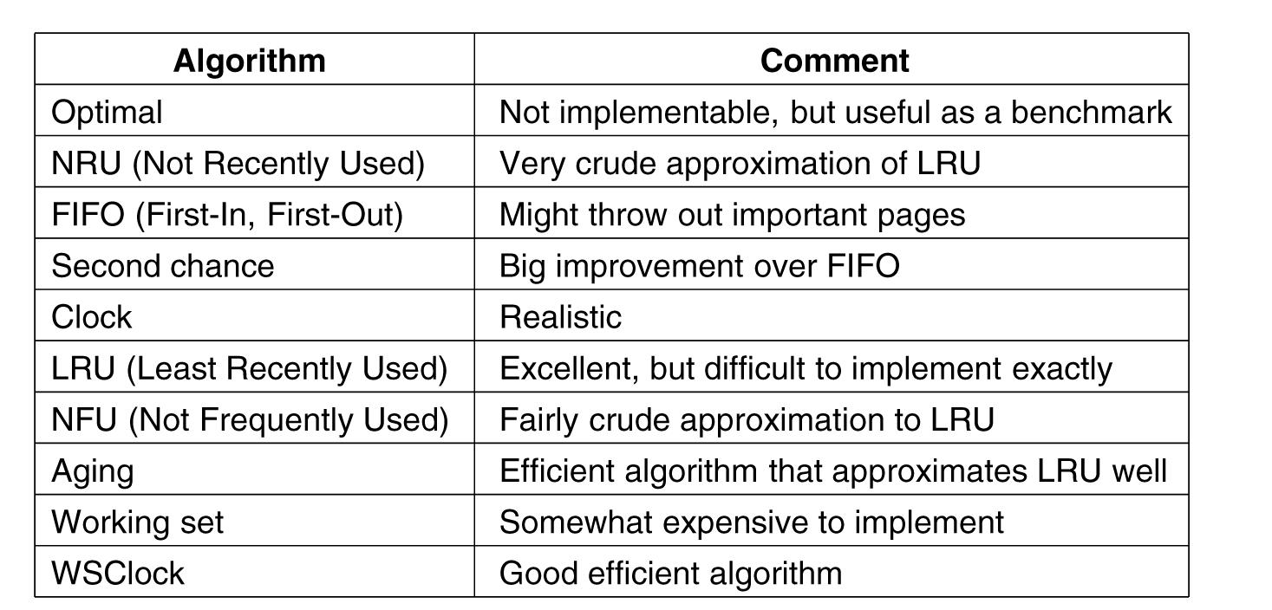
Summary of Page Replacement Algorithms
Figure 3-21. Page replacement algorithms discussed in the text.

Slide 83
Page Size
It is really a tradeoff and balance among several factors
Small page size
Pros?
Low internal fragmentation
Avoids loading unnecessary program/data and waste of memory
Cons?
Large page table, longer context switch
More times of page transfer
Large page size
The opposite!

Slide 84
Outline
Questions?
File Systems
Files
File system implementation
Implementing files
Implementing directories

Slide 85
File Systems
Essential requirements for long-term information storage:
It must be possible to store a very large amount of information.
The information must survive the termination of the process using it.
Multiple processes must be able to access the information concurrently.

Slide 86
File Systems
Files
Logical units of information created by processes (abstraction)
File system
An OS component that manages files

Slide 87
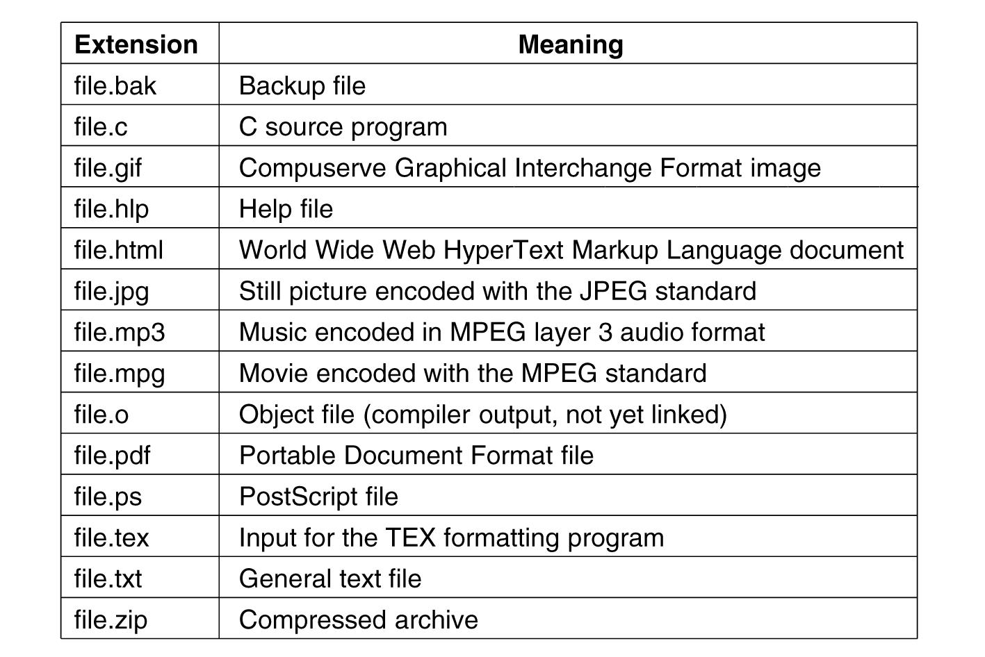
File Naming
Exact file naming rules vary among OSs
E.g. some distinguish between upper/lower case letters whereas others don’t
Usually a two-part file name, separated by a period
The part after the period is called file extension
Figure 4-1. Some typical file extensions.

Slide 88
File Types (1)
Regular files
ASCII files
Binary files
Directories
$file foo.c
Determines file type
Notes:
ASCII files contain lines of text and each line ends by a carriage return character. -> can be edited in text editor
Binary files only for specific program. For example executable files.

Slide 89
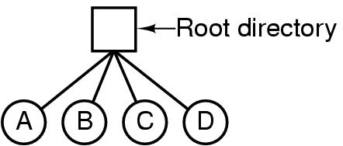
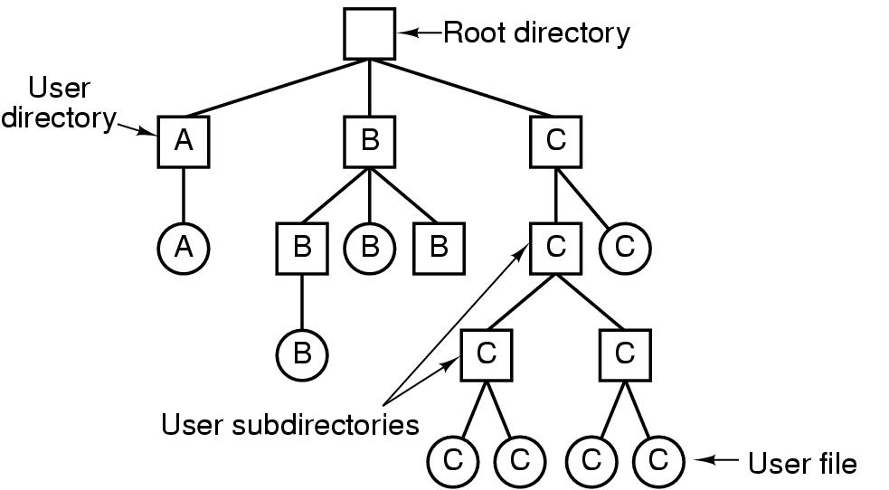
Directories
Directories/folders
Keep track of files (a collection of files/dirs)
Single-level directory systems
Hierarchical directory systems
Figure 4-6. A single-level directory system containing four files.
Figure 4-7. A hierarchical directory system.

Slide 90
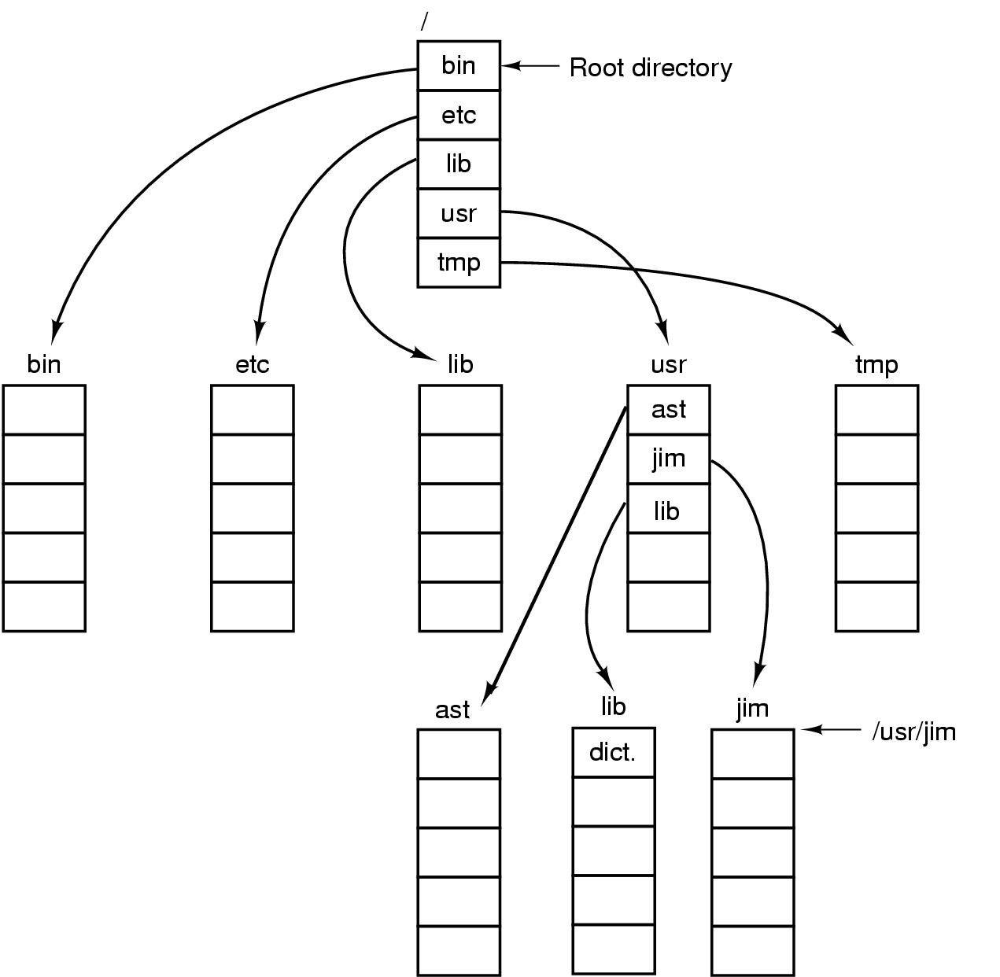
A UNIX directory tree
Figure 4-8. A UNIX directory tree.

Slide 91
File System Layout
MBR: (Master Boot Record)
Boot block
Superblock
Figure 4-9. A possible file system layout.
Notes:
Master Boot Record is used to boot the computer.
Partition table contain the starting and ending address of each partition.

Slide 92
Implementing Files (2)
OS needs to keep track of which block goes to which file
Contiguous allocation
Linked List Allocation
Linked List Allocation Using a Table in Memory
i-nodes

Slide 93
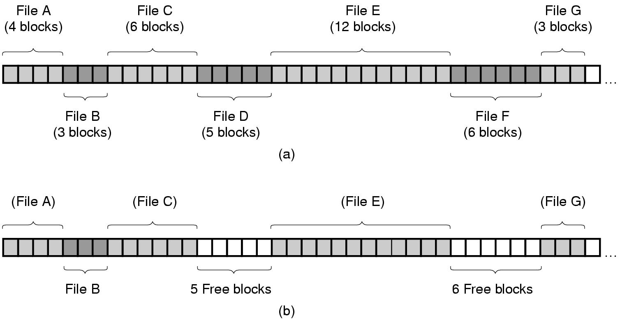
Contiguous Allocation (1)
Figure 4-10. (a) Contiguous allocation of disk space for 7 files.
(b) The state of the disk after files D and F have been removed.

Slide 94
Contiguous Allocation (2)
Pros
Simple to implement (only need to know start addr and num. of blocks)
Sequential access: good performance. Remember the disc structure?
Cons
Need to know file size in advance
Fragmentation (external fragmentation). How to reduce external fragmentation?

Slide 95
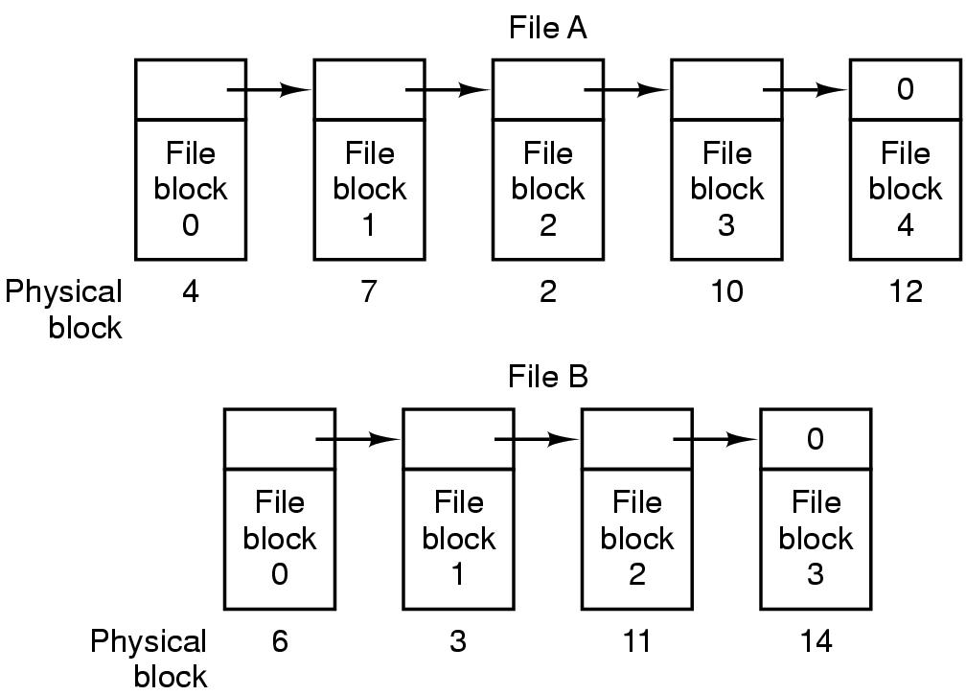
Linked List Allocation (1)
Figure 4-11. Storing a file as a linked list of disk blocks.

Slide 96
Linked List Allocation (2)
Pros
No need to know file size in advance
No external fragmentation, only internal fragmentation
Cons
Random access is slow: need to traverse the next pointer. For example, what is the physical block of the third block of file B?
Irregular storage management: not power of 2 any more. Why?
Notes:
not power of 2 any more due to small size for the next pointer

Slide 97
Linked List Allocation Using a Table in Memory (1)
File Allocation Table (FAT)
Figure 4-12. Linked list allocation using a file allocation table in main memory.

Slide 98
Linked List Allocation Using a Table in Memory (2)
Pros
No need to know file size in advance
No external fragmentation, only internal fragmentation
Easy random access (FAT is entirely in memory -> no disk reference)
Regular storage management (no extra pointer)
Cons
Entire table must be in memory, needing huge memory space
Example on page 286

Slide 99
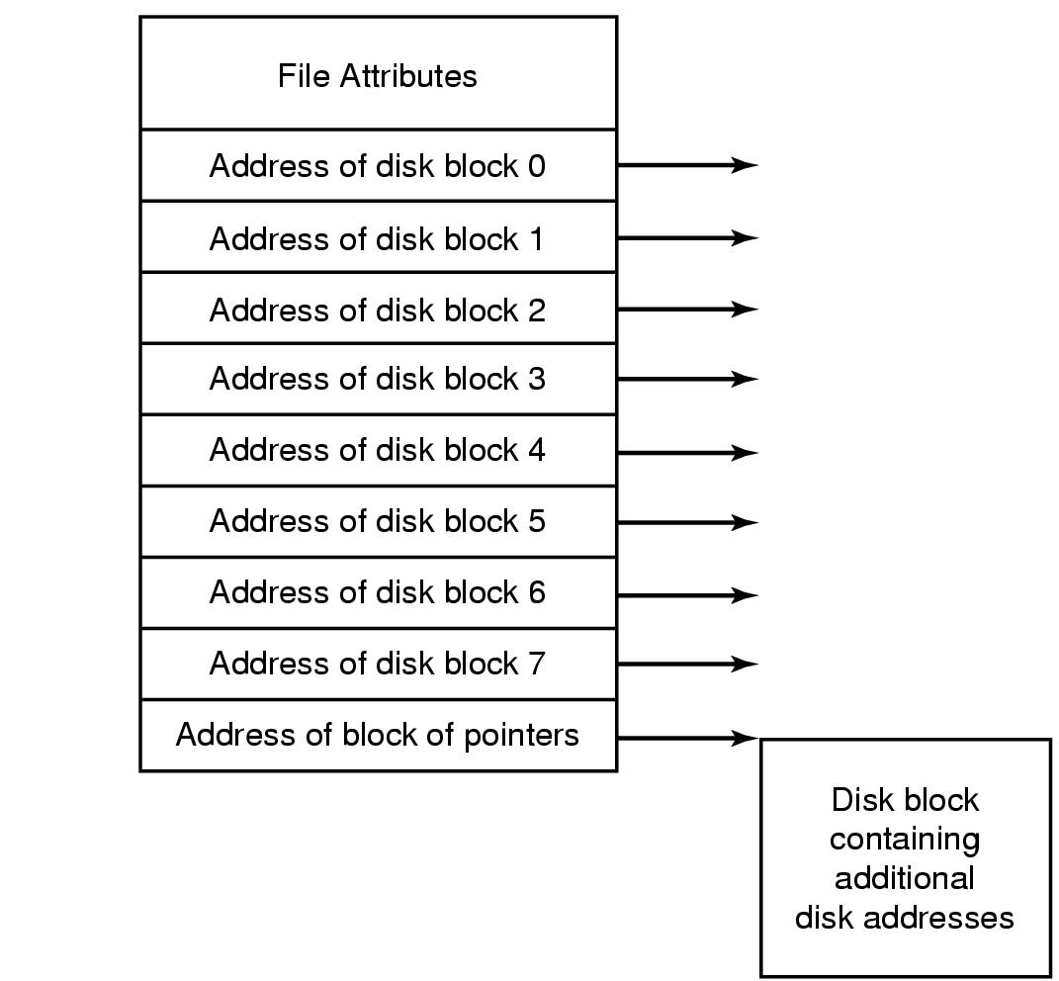
i-nodes
i-nodes: index-nodes
Have all advantages of FAT, plus controlled memory consumption:
i-node only need to be in memory when the file is open
Figure 4-13. An example i-node.

Slide 100
i-nodes
Pros
Only i-nodes of opened files need to be in memory -> not proportional to the disk size
Cons
When a file grows beyond the fixed number of block for each i-nodes?
The solution is to reserve the lost disk address for another i-nodes (see the previous Figure) -> becomes linked list.
Notes:
FAT is proportional to the disk size

Slide 101
Disk Space Management: Block Size (1)
Block size selection is a tradeoff, similar as page size
Large block size
Better performance, more storage waste due to fragmentation (less storage utilization)
Small block size
Better storage utilization (less fragmentation), more seeks and rotational delays (lower performance)

Slide 102
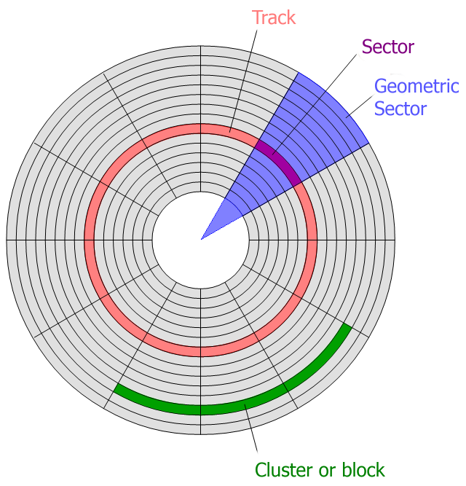
Example on page 301
The image is retrieved from http://keywordsuggest.org/gallery/807348.html

Slide 103
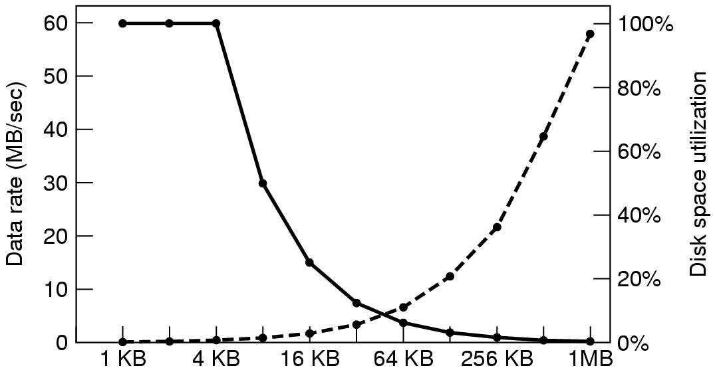
Disk Space Management Block Size (3)
Figure 4-21. The dashed curve (left-hand scale) gives the data rate of a disk. The solid curve (right-hand scale) gives the disk space efficiency. All files are 4 KB.
Notes:
Performance and space utilization is in conflict.

Slide 104
Keeping Track of Free Blocks
Figure 4-22. (a) Storing the free list on a linked list. (b) A bitmap.

Slide 105
File System Backups (1)
File system backups often performed to recover from disaster
Full backup v.s. incremental backup (incremental dump)
Physical dump v.s. logical dump (dominant)
Physical dump simple and perform fast, but incapable of skipping bad blocks, incremental backups, and restoring individual files

Slide 106
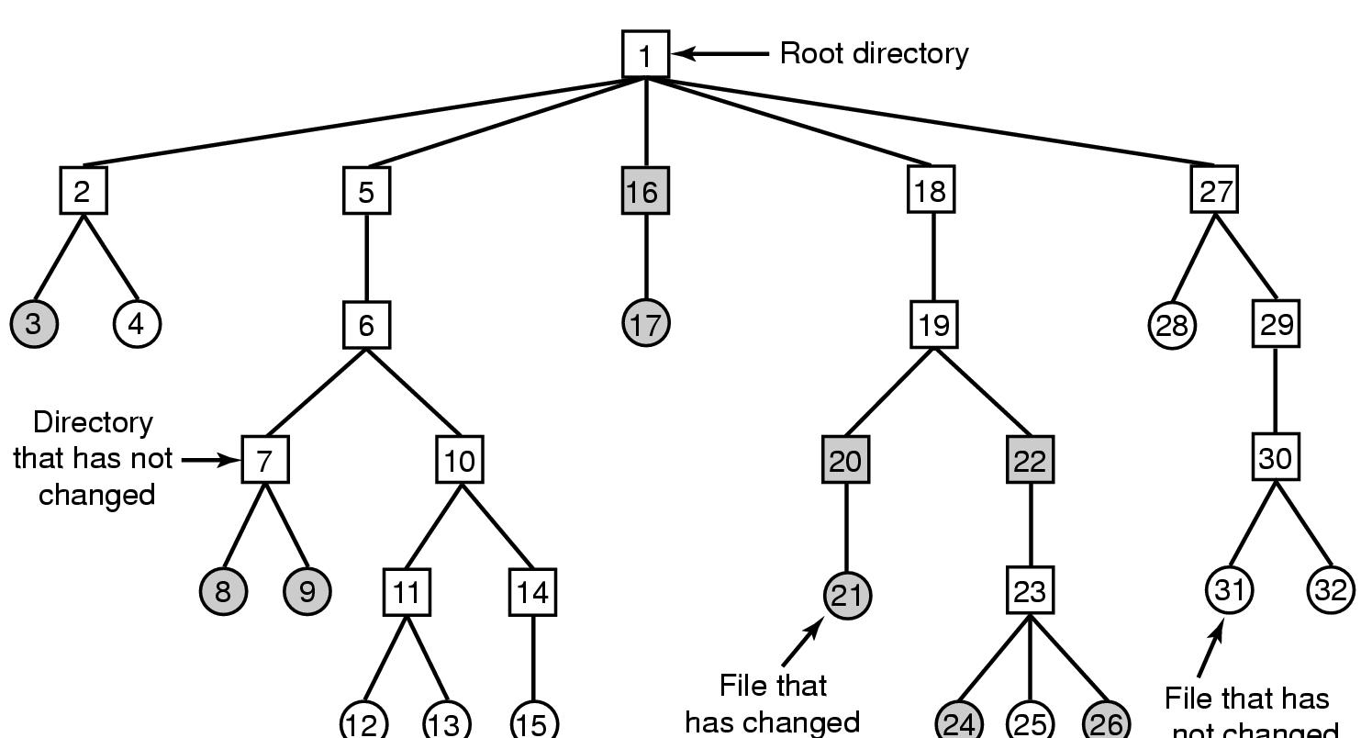
File System Backups (2)
A typical backup algorithm example
Figure 4-25. A file system to be dumped. Squares are directories, circles are files. Shaded items have been modified since last dump. Each directory and file is labeled by its i-node number.

Slide 107
File System Performance
Access to disk is much slower than access to memory
Typical techniques used for optimizing file system performance
Caching
Block read ahead (prefetching)
Reducing disk arm motion

Slide 108
Caching (1)
Buffer Cache (Block Cache)
When a request comes in
Check to see if needed blocks in the cache; if yes, satisfied immediately
If not, bring the block into buffer cache (find a replacement victim if needed) and serves the request
Replacement algorithms discussed for paging system apply to buffer cache replacement too
Caching can also be “bypassed” (dis-abled) when not beneficial

Slide 109
Block Read Ahead
“Prefetching”
When the file system fetches the requested block k, it also fetches block k+1, k+2, …, k+d
Assuming and beneficial for sequential accesses
If a file is being randomly access -> it hurts

Slide 110
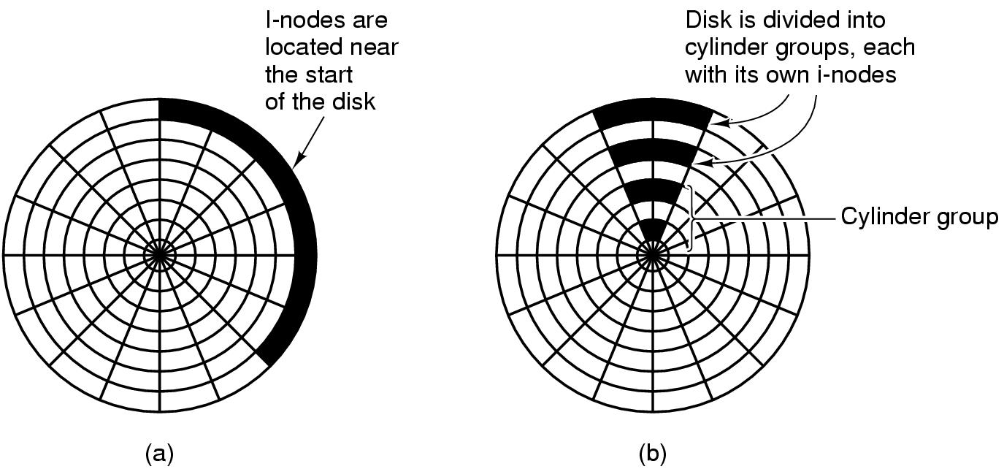
Reducing Disk Arm Motion
Placing contiguous blocks close, e.g. in the same cylinder
Placing i-node block in the middle of block: reduce the seeking time of the i-node and the fist block by a factor of 2
Using cylinder groups: i-node can be in any group but try to find block in the same (or nearby cylinder group).
Figure 4-29. (a) I-nodes placed at the start of the disk. (b) Disk divided into cylinder groups, each with its own blocks and i-nodes.
Notes:
When allocate a new block for a file, it is easier if free block are recorded in bitmap rather than in free list.

Slide 111
Outline
Example file systems
MS-DOS file system
Unix v7 file system
CD-ROM file systems

Slide 112
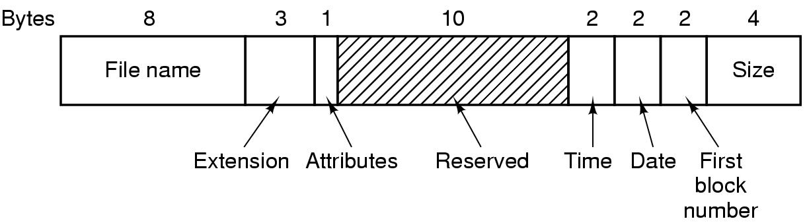
The MS-DOS File System (1)
Have been used through Windows 98/ME/XP
Uses a file allocation table (FAT) to keep track of free blocks
FAT-12, FAT-16, FAT-32: differ on the number of bits a disk address contains
Figure 4-30. The MS-DOS directory entry.
Notes:
Attributes: read-only, is Hidden, or is system file

Slide 113
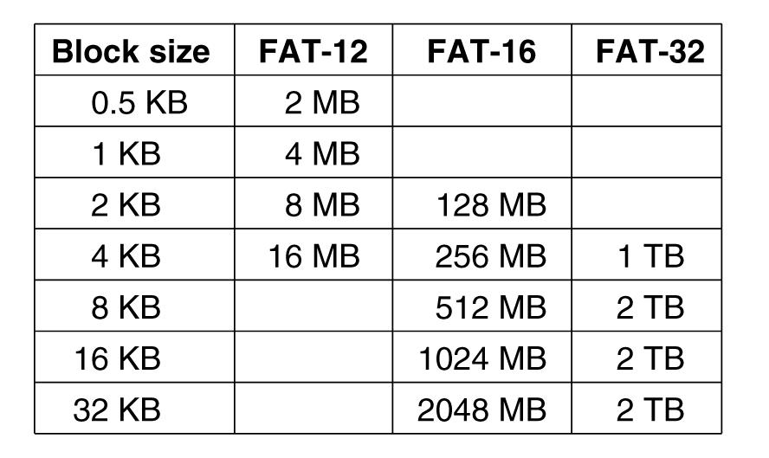
The MS-DOS File System (2)
Figure 4-31. Maximum partition size for different block sizes
Notes:
Eg FAT-16 with 2KB block size: 2^16*2^11=128MB

Slide 114
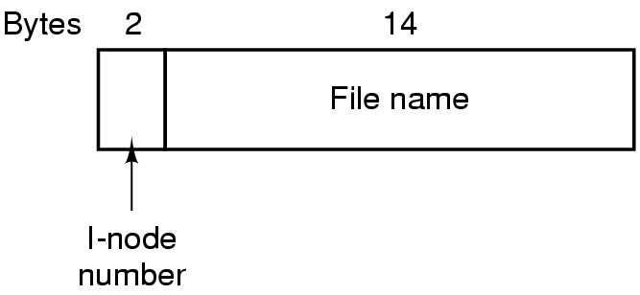
The UNIX V7 File System (1)
Hierarchical structure
What is the maximum number of files (including directories) per V7 file system can have?
Figure 4-32. A UNIX V7 directory entry.
Notes:
2 bytes = 16 bits. => 2^16 (or 64K) different files/directories

Slide 115
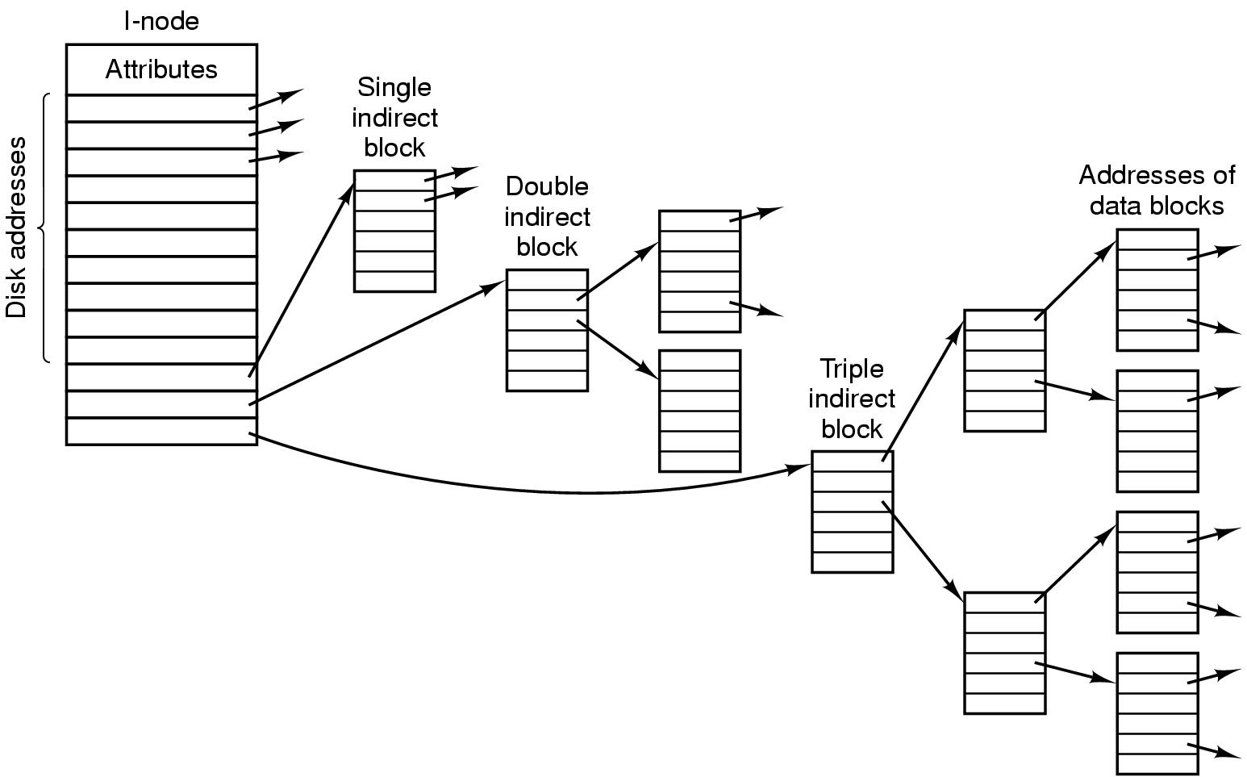
The UNIX V7 File System (2)
Figure 4-33. A UNIX i-node.
Notes:
10*1KB + 256 * 1KB + 256 * 256 * 1KB

Slide 116
Device Controllers
I/O devices typically consist of a mechanical component and an electronic component
Mechanical component: The device itself
Electronic component: Device controller (or adapter)
Often follows a standard interface
E.g. ANSCI, IEEE, ISO, USB, FireWire (IEEE 1394)
Has registers (for commands) and data buffer to communicate with CPU, e.g. video RAM

Slide 117
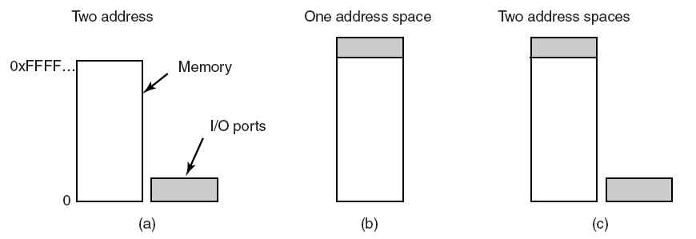
Direct I/O
Two alternatives exist for how CPU communicates with the control registers and the device data buffers
Direct I/O (separate I/O and memory space, I/O-mapped I/O)
Each control register assigned an I/O port number (forms an I/O port space)
Use explicit I/O instruction to access I/O
E.g. IN REG, PORT; OUT PORT, REG
Completely different address spaces
for memory and I/O
Figure 5-2. (a) Separate I/O and memory space

Slide 118
Memory-Mapped I/O (1)
Memory-mapped I/O: map all control registers into the memory space (single unified address space)
Control registers assigned unique memory addresses (at top)
Usually a second signal line used to tell whether I/O space or memory space needed, then memory or I/O responds
Hybrid scheme also exists
Figure 5-2. (b) Memory-mapped I/O. (c) Hybrid.

Slide 119
Memory-Mapped I/O (2)
Advantages
Device control registers can be addressed in C/C++ (like other variables) thus programs can be written entirely in C/C++
No special protection needed, OS simply refrains from putting the portion of address space containing control registers to any virtual address space
Every instruction that can reference memory can be used to reference control registers

Slide 120
Memory-Mapped I/O (3)
Disadvantages
Caching is problematic, need to disable caching control registers, per page basic -> add complexity

Slide 121
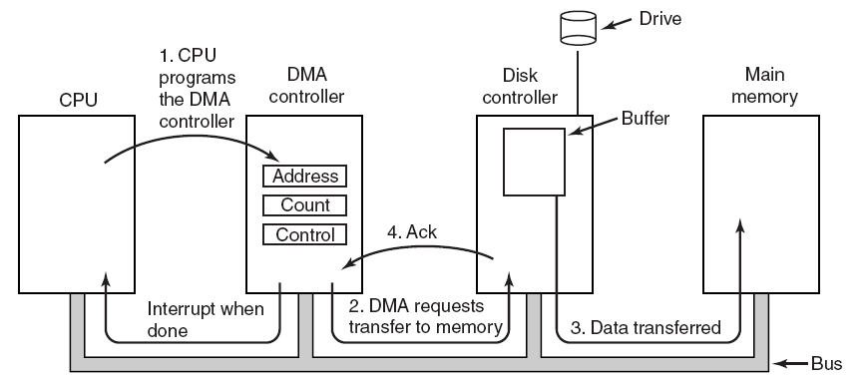
Direct Memory Access (DMA)
CPU can waste cycles if directly interacts with I/O devices
A DMA scheme is often used to free up CPU
Figure 5-4. Operation of a DMA transfer.
Notes:
Without DMA, OS use CPU to transfer byte by byte or word by word between Main memory and I/O devices.
DMA can be on each device controller or on the mother board.
DMA can handle multiple transfers at a time -> Scheduling FIFO, or round robin

Slide 122
Direct Memory Access (DMA)
DMA varies, the simple one handles one transfer at a time
Complex ones handle multiple transfers once
Device internal buffer needed even with DMA as:
Verify the checksum before a DMA transfer
Better efficiency

Slide 123
Outline
Questions?
Quiz 3 review
Principles of I/O Hardware
I/O devices and device controllers
Memory-mapped I/O and Direct Memory Access (DMA)
Principles of I/O Software
Goals of I/O software
Programmed I/O, interrupt-driven I/O and I/O using DMA

Slide 124
Goals of the I/O Software (1)
Device independence
Programs developed should be independent from devices
E.g. read a file on a hard disk drive/CD-ROM/DVD/USB drive
OS needs to take care of the difference of devices and hides them
Uniform naming
Name of a device should be a string or an integer, independent from the device
Error handling
Error handling should be as close to the hardware as possible
E.g. controller -> device driver -> upper layers

Slide 125
Goals of the I/O Software (2)
Synchronous v.s. Asynchronous
Synchronous: blocking (lower performance), easier to develop programs
Asynchronous: interrupt-driven, non-blocking, harder to develop
Buffering (often needed)
Sharable v.s. dedicated devices
Some devices can be shared by multiple users simultaneously, e.g. disks, whereas some others are not, e.g. printers

Slide 126
Readings
Chapter 5:
Section 5.1
Section 5.2

Slide 127
Device Drivers (1)
Device driver: a device-specific code that controls devices
Normally provided by devices’ manufacturer
Usually handles one device type or one class of related devices
Normally part of OS kernel
Normally needs OS to have a well-defined model for what an outsider driver does and how interacts with the rest OS

Slide 128
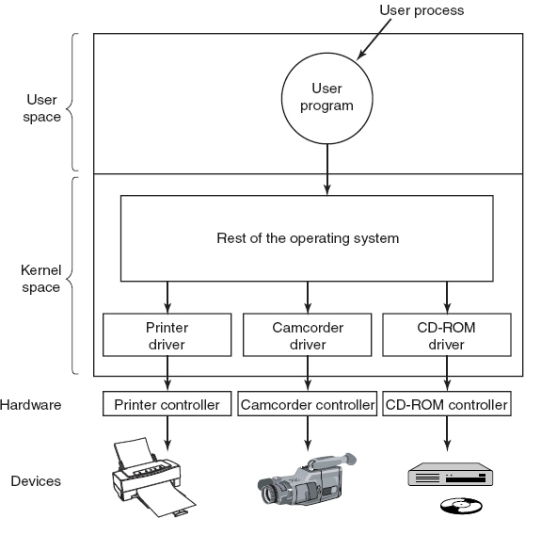
Device Drivers (2)
Figure 5-12. Logical positioning of device drivers. In reality all communication between drivers and device controllers goes over the bus.

Slide 129
Device Drivers (3)
Functionalities
Accept abstract read/write requests from the device-independent software above it
Manage devices, initialize devices, manage power and logs

Slide 130
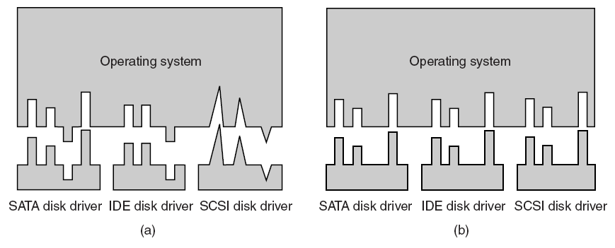
Uniform Interfacing for Device Drivers
Same driver interface desired
OS defines a set of functions that drivers must supply
OS sets unified device names as well, e.g. with major device number and minor device number
Figure 5-14. (a) Without a standard driver interface. (b) With a standard driver interface.

Slide 131

Summary of I/O Software Layers
Figure 5-17. Layers of the I/O system and the main functions of each layer.

Slide 132
Outline
Questions?
Principles of I/O Software
Programmed I/O, interrupt-driven I/O and I/O using DMA
I/O Software Layers
Interrupt handlers, device drivers
Device-independent I/O software, user-space I/O software
Disks
Magnetic disks

Slide 133

Magnetic Disks

Slide 134

Disk Drive Performance
Write/Read Requests arrive at the disk as block (sector) requests
Seek Time: Disk head must move to the correct track
Latency: Time for the rotation of the disk to reach the correct sector
Best Case: 0
Worst Case: Full Rotation (15K RPM = 250 RPS = 4 millisecs)
Access Time
Seek Time + Latency + Transfer Time

Slide 135

Disk Arm Scheduling Algorithms (2)
FCFS performs poorly and has low efficiency even fair
E.g. requests: cylinder 11, 1, 36, 16, 34, 9, 12
Shortest Seek First (SSF) optimizes seek time but loses fairness
Figure 5-24. Shortest Seek First (SSF) disk scheduling algorithm.

Slide 136

Disk Arm Scheduling Algorithms (3)
Elevator algorithm
Moving UP
Moving DOWN
Figure 5-25. The elevator algorithm for scheduling disk requests.

Slide 137

Clocks and Clock Hardware (1)
Clocks (timers) maintain time and generate interrupts
Old clocks use voltage cycle to generate interrupt at 50/60Hz
Common clocks nowadays use crystal oscillator (up to 1000MHz)
Interrupt intervals can be programmed with the register, “clock ticks”
Figure 5-28. A programmable clock.

Slide 138
THE END

